Slide 1
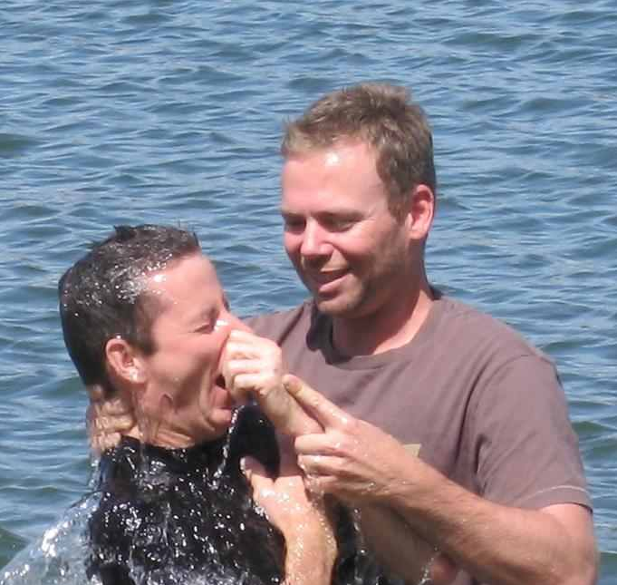
Things New Converts Need to Know
They need to prepare themselves for hardships (2 Tim. 3:12; Luke 6:26; 3 John 9-10; 1 Pet. 3:14; 4:15-16).

Slide 2
Things New Converts Need to Know
They need to face doubts immediately (2 Pet. 1:10; 1 Pet. 3:15).

Slide 3
Things New Converts Need to Know
They need to feel valued like everyone else (1 Pet. 1:23; 1 Pet. 2:9; Luke 15:23; 1 Cor. 12:12-14 ).

Slide 4
Things New Coverts Need to Know
They are without excuse for unfaithfulness (Matt. 13:6, 21; 1 John 1:8-2:1; Acts 8:20-24).

