Slide 1
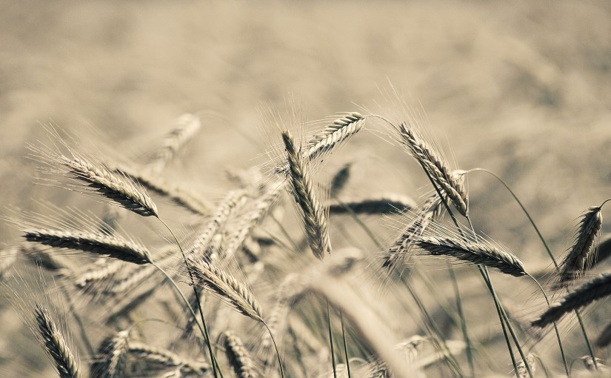
Patience
James 1:2-4

Slide 2
What Is Patience?
makrothumia (μακροθυμία)
macros – “long,” thumos – “wrath, temper”
“That quality of self restraint in the face of provocation which does not hastily or promptly punish” (Vine’s)
Patience is the ability to wait or endure without complaint, forbearing, refusing to be provoked or angered.

Slide 3
What Is Patience?
hupomonē (ὑπομονή)
hupo – “under,” menō – “to abide”
The ability to bear under a load and keep going.

Slide 4
What Is Patience?
Makrothumia generally expresses patience with regard to people.
Hupomonē generally expresses patience with regard to things.

Slide 5
The Value of Patience
We gain our souls (Luke 21:19; Heb. 6:11-12).
Endure hardships (Heb. 10:36).
Necessary to bear fruit (Luke 8:15).
Helps us wait on the Lord (Rom. 8:25).

Slide 6
The Patience of God
God is patient with us
Psalm 103:8-14
2 Peter 3:9

Slide 7
When Do We Need Patience?
When dealing with others (1 Thess. 5:14).
In our homes (Col. 3:18-21).
In the church (Eph. 4:1-3).
While awaiting the Lord (James 5:7-8).

