Slide 1
Luke 18:3-8
Now there was a widow in that city; and she came to him, saying, ‘Get justice for me from my adversary.’ And he would not for a while; but afterward he said within himself, ‘Though I do not fear God nor regard man, ‘yet because this widow troubles me I will avenge her, lest by her continual coming she weary me.’”

Slide 2
Luke 18:3-8
Then the Lord said, “Hear what the unjust judge said. And shall God not avenge His own elect who cry out day and night to Him, though He bears long with them? I tell you that He will avenge them speedily. Nevertheless, when the Son of Man comes, will He really find faith on the earth?” (NKJV).

Slide 3
“When the Son of Man Comes will He Really Find Faith on the Earth?”
“‘Nones’ on the Rise.”
October 9, 2012
No Religious Affiliation
68% Believe in God
37% “Spiritual” not religious
21% Pray daily
http://www.pewforum.org/2012/10/09/nones-on-the-rise/
2007
15%
2012
20%

Slide 4
“When the Son of Man Comes will He Really Find Faith on the Earth?”
The “Dones”
Josh Packard
People who were once very religious
They grow tired of “the Sunday routine of plop, pray and pay.” They “want to participate. but they feel spurned at every turn.”
Thom Schultz “The Rise of the ‘Dones’”
http://www.thedones.com/the-rise-of-the-dones/

Slide 5
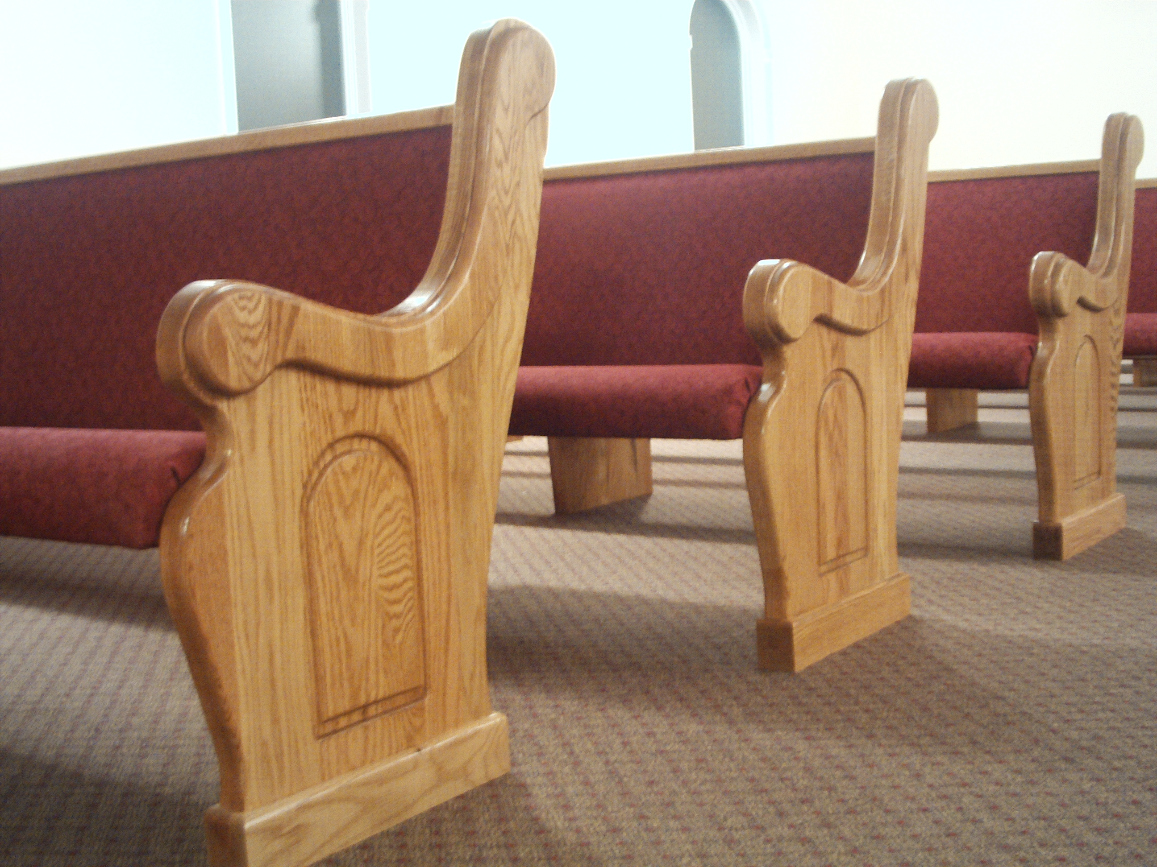
“Plop, Pray, and Pay”
I. Is There a “Plop, Pray, and Pay” Routine?
A. Do we practice vain worship?
Jesus condemned “vain” worship (Matt. 15:7-9).
Jesus condemned vain repetitions (Matt. 6:7-8).
Worship as God intended it is meaning-ful and not simply idle routine.

Slide 6
“Plop, Pray, and Pay”
I. Is There a “Plop, Pray, and Pay” Routine?
B. Does the fact that something is routine necessarily mean it is vain?
We are to assemble regularly (Heb. 10:23-24).
We are to do things “decently and in order” (1 Cor. 14:40).
The challenge is not to do something different every time, but to keep what we do routinely meaningful at all times.

Slide 7
“Plop, Pray, and Pay”
I. Is There a “Plop, Pray, and Pay” Routine?
C. Do we “pay” for worship?
1. Why does the church take up a collection?—It is commanded to carry out the work of the church (1 Cor. 16:1-2).
Support of preachers (1 Cor. 9:14).
Support of elders (1 Tim. 5:17-18).
Support of widows (1 Tim. 5:3-16).
Relief to needy saints (Acts 2:45).

Slide 8
“Plop, Pray, and Pay”
I. Is There a “Plop, Pray, and Pay” Routine?
C. Do we “pay” for worship?
2. Worship is not something for which we “pay.”
Contribution is a personal and voluntary act of worship (2 Cor. 9:7).
While Christians should choose to give in worship to God, the opportunity to worship is freely offered.

Slide 9
“Plop, Pray, and Pay”
II. Why Do “Dones” Come to Feel This Way?
A. Sometimes it comes from religious leaders’ unwillingness to answer questions.
“When I have wanted to engage in conversation about why the pastor is the one that gets paid and not the others in the 5-fold ministry… any and all questions have been defensively dismissed” (Johanna).

Slide 10
“Plop, Pray, and Pay”
II. Why Do “Dones” Come to Feel This Way?
A. Sometimes it comes from religious leaders’ unwillingness to answer questions.
1. We are to “Test all things; hold fast what is good” (1 Thess. 5:21).

Slide 11
“Plop, Pray, and Pay”
II. Why Do “Dones” Come to Feel This Way?
B. Sometimes it is because members of a church have failed to show love.
“When I was diagnosed with cancer only parishioners visited and no one sat with my husband at my second surgery” (Southern Lady).

Slide 12
“Plop, Pray, and Pay”
II. Why Do “Dones” Come to Feel This Way?
B. Sometimes it is because members of a church have failed to show love.
1. All members are to care for one another, especially when we face illness (Matt. 25:34-40).
This is not just the responsibility of preachers or elders—all Christians should do this as we are able.

Slide 13
“Plop, Pray, and Pay”
II. Why Do “Dones” Come to Feel This Way?
C. Sometimes it is a response to man-made religions.
“I have never encountered in any church I’ve been involved in anything that resembles the church in the book of Acts… the church has been replaced by going to a man-made organization and show…” (Brett).

Slide 14
“Plop, Pray, and Pay”
II. Why Do “Dones” Come to Feel This Way?
C. Sometimes it is a response to man-made religions.
1. If a religious group doesn’t follow the patterns of Scripture it is not the Lord’s Church (2 Tim. 1:13; Phil. 4:9).

Slide 15
“Plop, Pray, and Pay”
II. Why Do “Dones” Come to Feel This Way?
D. Sometimes it is a rejection of what the Bible says.
“I can not sit thru another worship service celebrating ‘Love for all’ when it is all white, all English, all heterosexual” (Southern Lady).
The Bible condemns homosexuality.

Slide 16
“Plop, Pray, and Pay”
II. Why Do “Dones” Come to Feel This Way?
D. Sometimes it is a rejection of what the Bible says.
“One of my children asked, ‘Couldn’t we just find a church that welcomes gay people?’” (Jill).
This is not a desire for proper attitudes— it is tolerance of sinful practice.

Slide 17
“Plop, Pray, and Pay”
II. Why Do “Dones” Come to Feel This Way?
D. Sometimes it is a rejection of what the Bible says.
1. All sinners are acceptable before God if they turn from their sin in obedience to the gospel (1 Cor. 6:9-11).

Slide 18
“Plop, Pray, and Pay”
II. Why Do “Dones” Come to Feel This Way?
D. Sometimes it is a rejection of what the Bible says.
“…All members are gifted to minister and, yes, even teach. I’m drawn to the organic church where leadership positions are few, if any, and all are on equal footing…” (Lucy).

Slide 19
“Plop, Pray, and Pay”
II. Why Do “Dones” Come to Feel This Way?
D. Sometimes it is a rejection of what the Bible says.
2. Elders (or deacons) are to be the “husband of one wife” (1 Tim. 3:2; cf. 3:12)—lit. “a one woman man.”
3. The word of God teaches restrictions on women’s roles in the church (1 Cor. 14:34-35; 1 Tim. 2:11-12).

Slide 20
“Plop, Pray, and Pay”
II. Why Do “Dones” Come to Feel This Way?
E. Sometimes it is because of personal desires.
“I am done. On Sunday a.m. and all day Sunday, I’ll be out somewhere in nature, sunshine or snow, getting healthy exercise and enjoying God’s creation. With other like-minded believers, if they don’t mind doing it on the hoof and aren’t determined to be completely sedentary on Sunday” (Andrew).

Slide 21
“Plop, Pray, and Pay”
II. Why Do “Dones” Come to Feel This Way?
E. Sometimes it is because of personal desires.
1. The Bible teaches Christians to meet on Sunday, “the first day of the week” (Acts 20:7).

Slide 22
“Plop, Pray, and Pay”
II. Why Do “Dones” Come to Feel This Way?
E. Sometimes it is because of personal desires.
“I see that church is good for everyone for a while but not for everyone for all of life. Unless your called to teach or pastor, it isn’t beneficial to be a choir member to be preached to week-in, week-out till you die” (Ryan).

Slide 23
“Plop, Pray, and Pay”
II. Why Do “Dones” Come to Feel This Way?
E. Sometimes it is because of personal desires.
2. The Bible teaches faithfulness to the Lord and service to Him for life (Rev. 2:10).

