Slide 1
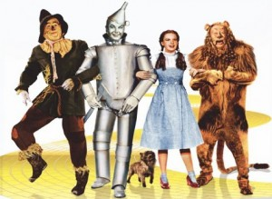

Slide 2
Challenges facing Christians today

Slide 3
Everyday Faith

Slide 4
pray every day
Mt 6:11 “Give us this day our daily bread”
Everyday

Slide 5
pray every day
Carry Cross Every Day
Lk 9:23 “And He was saying to them all, ‘If anyone wishes to come after Me, let him deny himself, and take up his cross daily, and follow me.”
Everyday

Slide 6
pray every day
Carry Cross Every Day
Encourage Every day
Heb 3:13 “But encourage one another day after day…”
Everyday

Slide 7
pray every day
Carry Cross Every Day
Encourage Every day
Engaged Spiritually every day
Everyday

Slide 8
Acts 5:42 And every day, in the temple and from house to house, they kept right on teaching and preaching Jesus as the Christ.

Slide 9
Acts 17:11 Now these were more noble-minded than those in Thessalonica, for they received the word with great eagerness, examining the Scriptures daily to see whether these things were so.

Slide 10
Being a Christian was part of their inner fiber
Galatians 3:27 For all of you who were baptized into Christ have clothed yourselves with Christ.
Romans 13:14 But put on the Lord Jesus Christ, and make no provision for the flesh in regard to its lusts.

Slide 11
C H R I S T
Love
In
Trouble
School
Ephesians 1:7-14
Ephesians 2:11-13

Slide 12
Everyday Faith
Inconsistency is what confuses people, draws the criticism of being a hypocrite
Inconsistency is what hurts our family

Slide 13
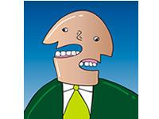
Jas 3:9-12

Slide 14
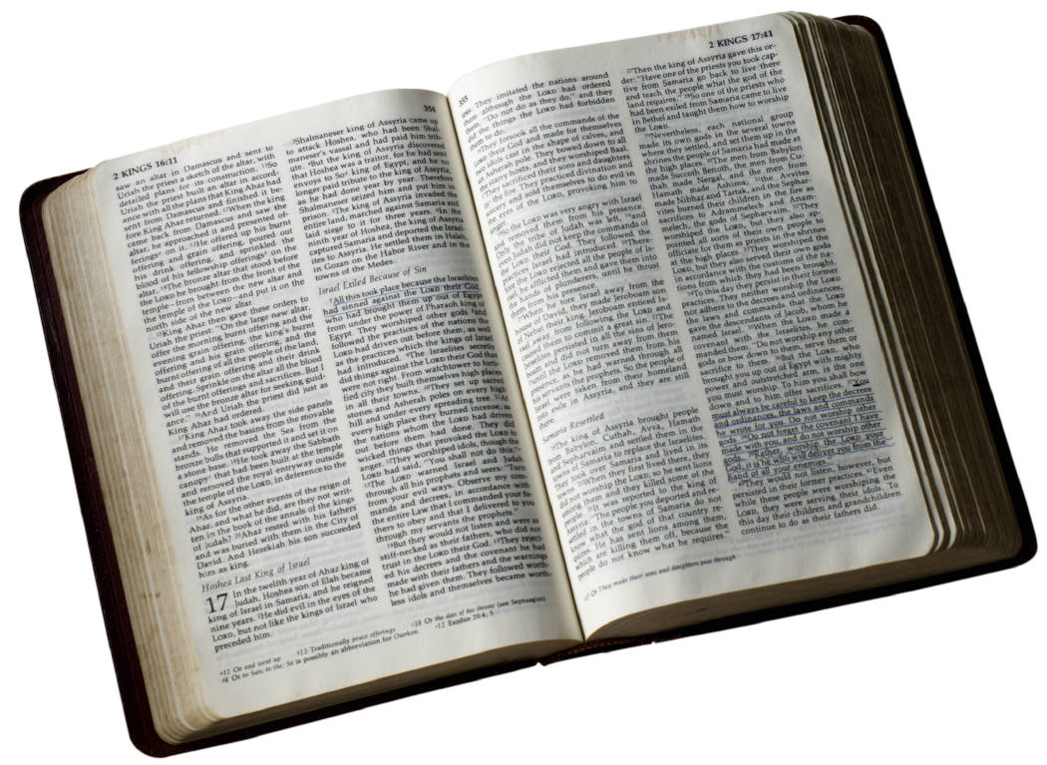
James 1:5-8 But if any of you lacks wisdom, let him ask of God, who gives to all generously and without reproach, and it will be given to him. But he must ask in faith without any doubting, for the one who doubts is like the surf of the sea, driven and tossed by the wind. For that man ought not to expect that he will receive anything from the Lord, being a double-minded man, unstable in all his ways.

Slide 15
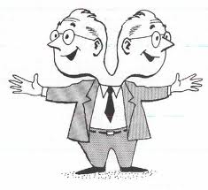
The double minded man
He prays but does not believe
The double minded man is inconsistent
His is unstable

Slide 16
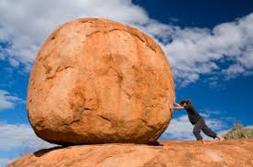
1 Corinthians 15:58 Therefore, my beloved brethren, be steadfast, immovable, always abounding in the work of the Lord, knowing that your toil is not in vain in the Lord.

Slide 17
Ephesians 4:14 As a result, we are no longer to be children, tossed here and there by waves and carried about by every wind of doctrine, by the trickery of men, by craftiness in deceitful scheming;
Matthew 6:24 “No one can serve two masters; for either he will hate the one and love the other, or he will be devoted to one and despise the other. You cannot serve God and wealth.”

Slide 18
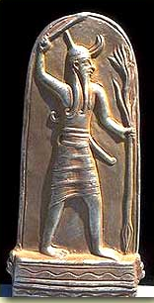
O.T. illustration of the double minded
Exodus 20:3-4 “You shall have no other gods before Me.” “You shall not make for yourself an idol, or any likeness of what is in heaven above or on the earth beneath or in the water under the earth.”

Slide 19
Solomon introduced idolatry
Nehemiah 13:26 Did not Solomon king of Israel sin regarding these things? Yet among the many nations there was no king like him, and he was loved by his God, and God made him king over all Israel; nevertheless the foreign women caused even him to sin.

Slide 20
Solomon introduced idolatry
Ahab married into mixed religion

Slide 21
God sends Elijah to Ahab
1 Kings 18:1 Now it happened after many days that the word of the Lord came to Elijah in the third year, saying, “Go, show yourself to Ahab, and I will send rain on the face of the earth.”
1 Kings 17:1 Now Elijah the Tishbite, who was of the settlers of Gilead, said to Ahab, “As the Lord, the God of Israel lives, before whom I stand, surely there shall be neither dew nor rain these years, except by my word.”

Slide 22
1 Kings 18:17-21
(17) People that do right are often accused of causing trouble

Slide 23
1 Kings 18:21 “And Elijah came near to all the people and said, ‘How long will you hesitate between two opinions? If the Lord is God, follow Him; but if Baal, follow him.’ But the people did not answer him a word.”

Slide 24
1 Kings 18:21 “And Elijah came near to all the people and said, ‘How long will you hesitate between two opinions? If the Lord is God, follow Him; but if Baal, follow him.’ But the people did not answer him a word.”

Slide 25
We find ourselves adopting the culture around us

Slide 26
1 Kings 18:21 “And Elijah came near to all the people and said, ‘How long will you hesitate between two opinions? If the Lord is God, follow Him; but if Baal, follow him.’ But the people did not answer him a word.”

Slide 27
1 Kings 18:21 “And Elijah came near to all the people and said, ‘How long will you hesitate between two opinions? If the Lord is God, follow Him; but if Baal, follow him.’ But the people did not answer him a word.”

Slide 28
Everyday Faith
Everyday invite the Lord into your life
How do I become an everyday Christian?
Everyday keep your priorities in line
Everyday use your faith

