Slide 1
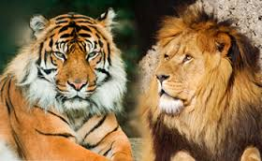
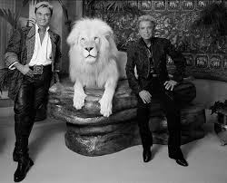

Slide 2
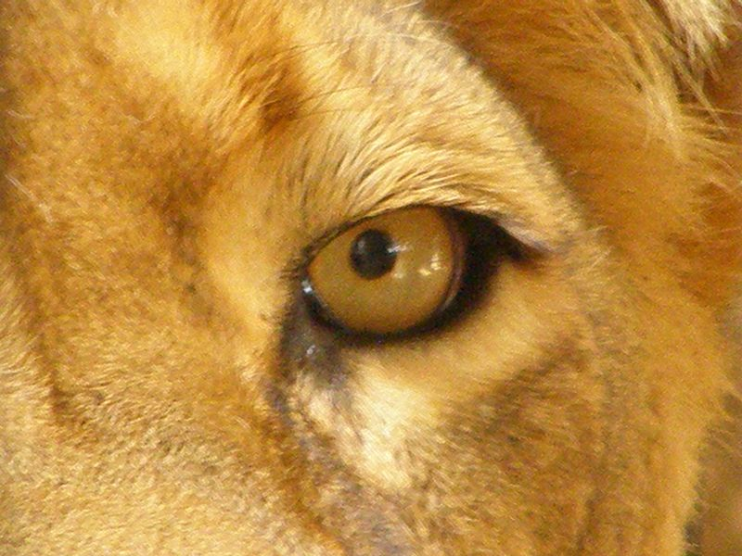
1 Peter 5:8 Be of sober spirit, be on the alert. Your adversary, the devil, prowls around like a roaring lion, seeking someone to devour.

Slide 3
Challenges facing Christians today
Temptation

Slide 4
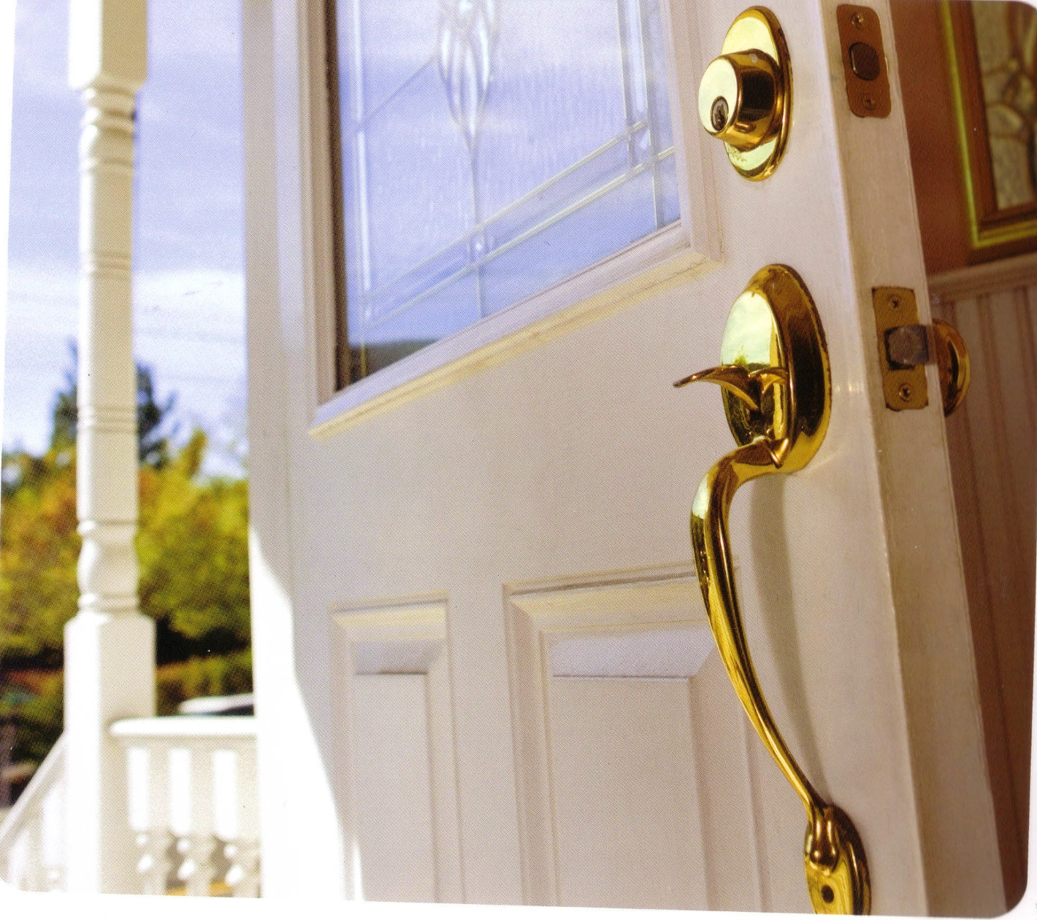
Satan knocks on the door of your heart
Resist the devil (James 4:7)
Lay aside the sin which so easily entangles us (Heb 12:1)
He knocks nearly every day

Slide 5
Satan
Jesus spoke of Satan on 25 X
Peter called him a “roaring lion”
In Revelation he is the “dragon”
He is called: Satan, Devil, Adversary

Slide 6
Satan
He is found in Genesis, deceiving Eve and in Revelation, deceiving the nations

Slide 7
Satan
He filled Judas’ heart to betray Jesus
He sought permission to sift Peter
The Bible never reveals one good thing about Satan

Slide 8
Satan
He was responsible for Job’s trials; Paul’s thorn in the flesh; the bent over woman’s crippling disease

Slide 9
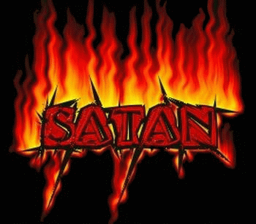
Satan
His origin is unclear; his future is certain
God made Hell for Satan (Mt 25:41)

Slide 10
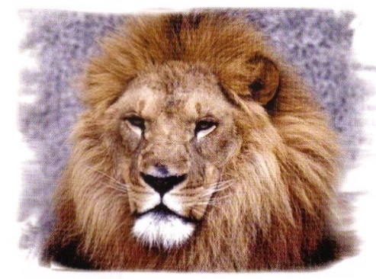
Three occasions in the Bible that Satan Speaks
Gen 3 – to Eve: deceive her
Job 1 – to God: denies the basis of man’s faith
Mt 4 – to Jesus: Tempted him
Each time he is wrong and he lies.

Slide 12
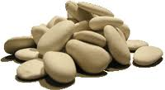
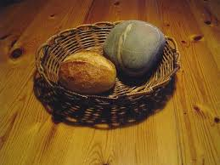
The first temptation: Turn rocks into bread
The word “If” is misleading. A better word would be “Since.”

Slide 13
Jesus never used a miracle for personal reasons
Acts 2:22 “Men of Israel, listen to these words: Jesus the Nazarene, a man attested to you by God with miracles and wonders and signs which God performed through Him in your midst, just as you yourselves know”

Slide 14
The first temptation: Turn rocks into bread
The word “If” is misleading. A better word would be “Since.”
“It is written” means “It stands written

Slide 15
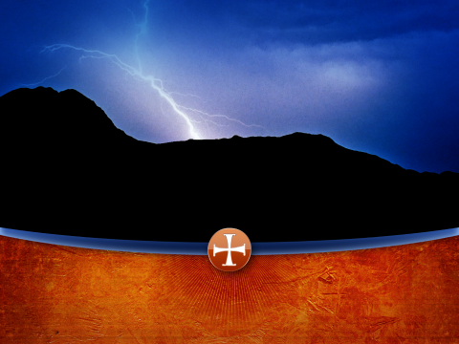
The Second temptation: Jump

Slide 16
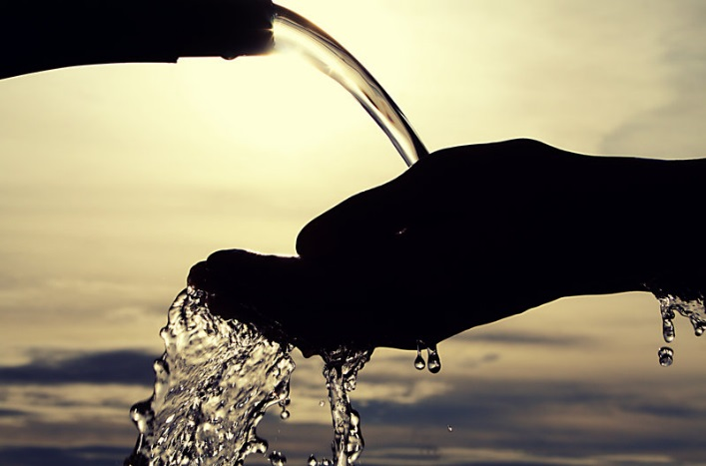
Ancient Israel had a problem with this:
Exodus 17:2 Therefore the people quarreled with Moses and said, “Give us water that we may drink.” And Moses said to them, “Why do you quarrel with me? Why do you test the Lord?”

Slide 17
Ancient Israel had a problem with this:
Exodus 17:3 But the people thirsted there for water; and they grumbled against Moses and said, “Why, now, have you brought us up from Egypt, to kill us and our children and our livestock with thirst?”

Slide 18
Exodus 17:7 He named the place Massah and Meribah because of the quarrel of the sons of Israel, and because they tested the Lord, saying, “Is the Lord among us, or not?”

Slide 19
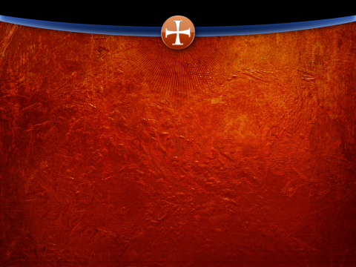
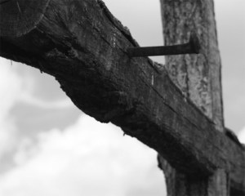
The Third temptation: Serve a New Master
Get the glory without the cross

Slide 20
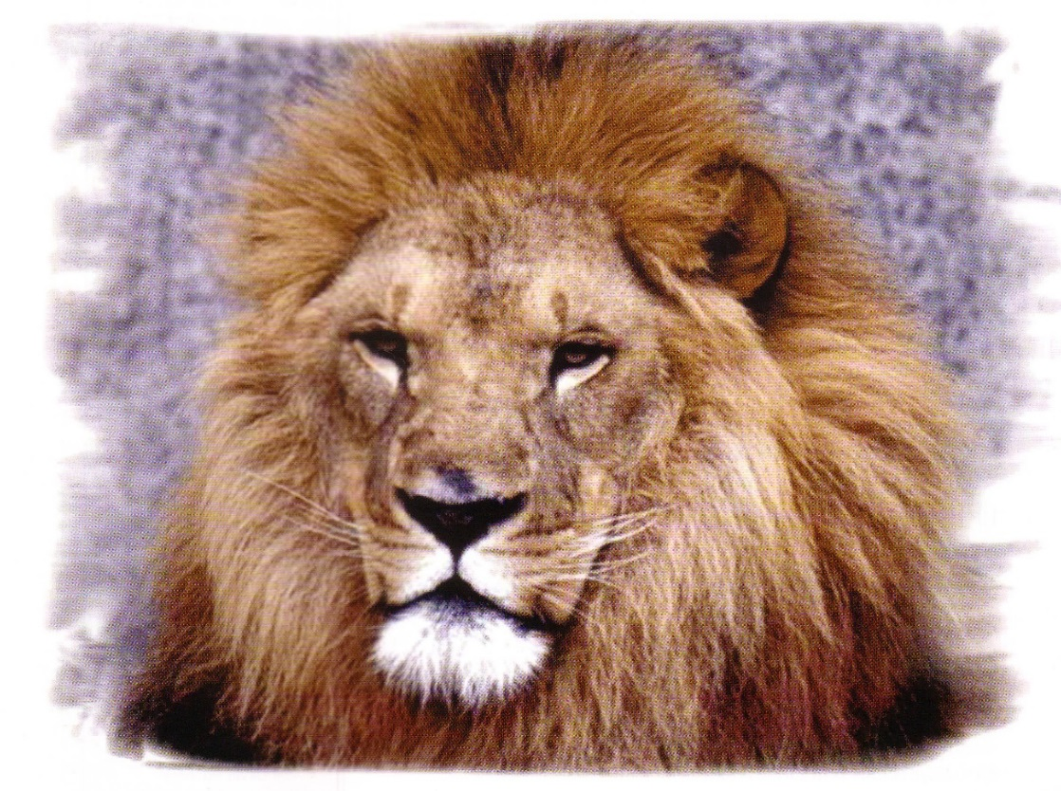
There is never a time, there is never a circumstance in which the Holy One would ever worship Satan. Never.

Slide 21
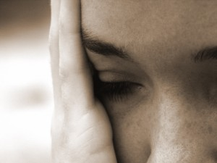
Satan uses our feelings, our emotions and our passions to confuse us
This is our stones to bread

Slide 22
Satan uses lust for the wrong to hide our eyes to the consequences
Gen 3:6 “When the woman saw that the tree was good for food, and that it was a delight to the eyes, and that the tree was desirable to make one wise, she took from its fruit and ate…”
He provides an opportunity for you to do wrong

Slide 23
Satan uses lust for the wrong to hide our eyes to the consequences
Gen 3:6 “When the woman saw that the tree was good for food, and that it was a delight to the eyes, and that the tree was desirable to make one wise, she took from its fruit and ate…”
He provides a crowd to encourage you

Slide 24
Satan uses lust for the wrong to hide our eyes to the consequences
Gen 3:6 “When the woman saw that the tree was good for food, and that it was a delight to the eyes, and that the tree was desirable to make one wise, she took from its fruit and ate…”
He provides an excuse to justify it

Slide 25
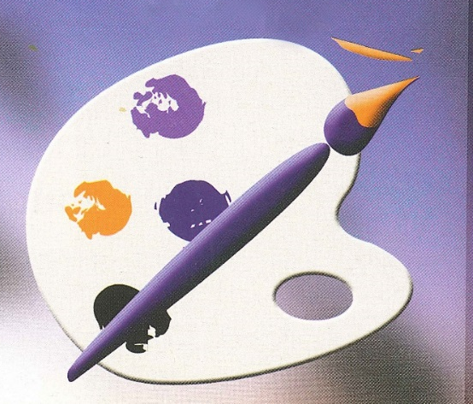
He paints two false pictures
God doesn’t really like you
Satan understands you
Satan doesn’t care about you
Jesus, upon the cross, tells us that God loves us

Slide 26
Colossians 2:13 When you were dead in your transgressions and the uncircumcision of your flesh, He made you alive together with Him, having forgiven us all our transgressions”

Slide 27
Satan will dangle the glitter of today to keep your eyes off the glory of tomorrow
This is our kingdoms of the world that Satan offers

Slide 28
Satan only has one day on his calendar—it’s today. It’s now.

Slide 29
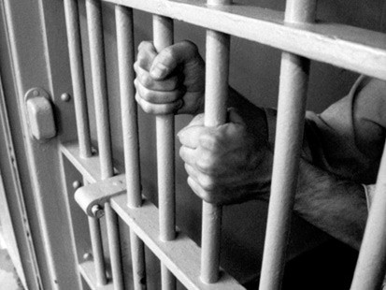
Sin takes you farther than you want to go…
Sin costs you more than you want to pay
Sin keeps you longer than you want to stay

Slide 30
2 Timothy 4:6-8 For I am already being poured out as a drink offering, and the time of my departure has come. I have fought the good fight, I have finished the course, I have kept the faith; in the future there is laid up for me the crown of righteousness, which the Lord, the righteous Judge, will award to me on that day; and not only to me, but also to all who have loved His appearing.

Slide 31
Satan will feed our souls the theology of the day to turn our hearts away from the true and living word of God
This is our jumping off the temple roof

Slide 32
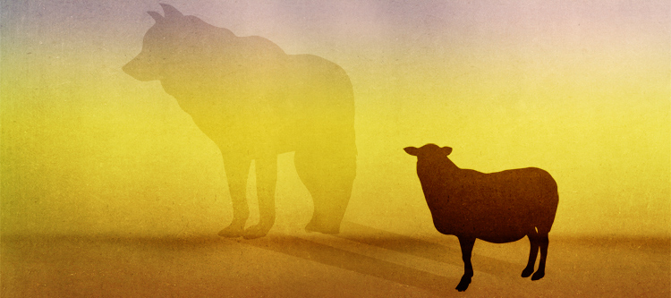
Matthew 7:15 “Beware of the false prophets, who come to you in sheep’s clothing, but inwardly are ravenous wolves.”

Slide 33
2 Corinthians 11:14 No wonder, for even Satan disguises himself as an angel of light.

Slide 34
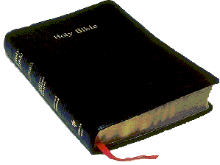
It is the word of God that saves us. It is the word of God that is always right.

Slide 35
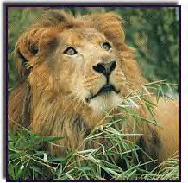
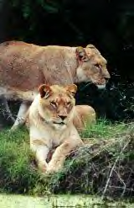
We are traveling though lion country

Slide 36
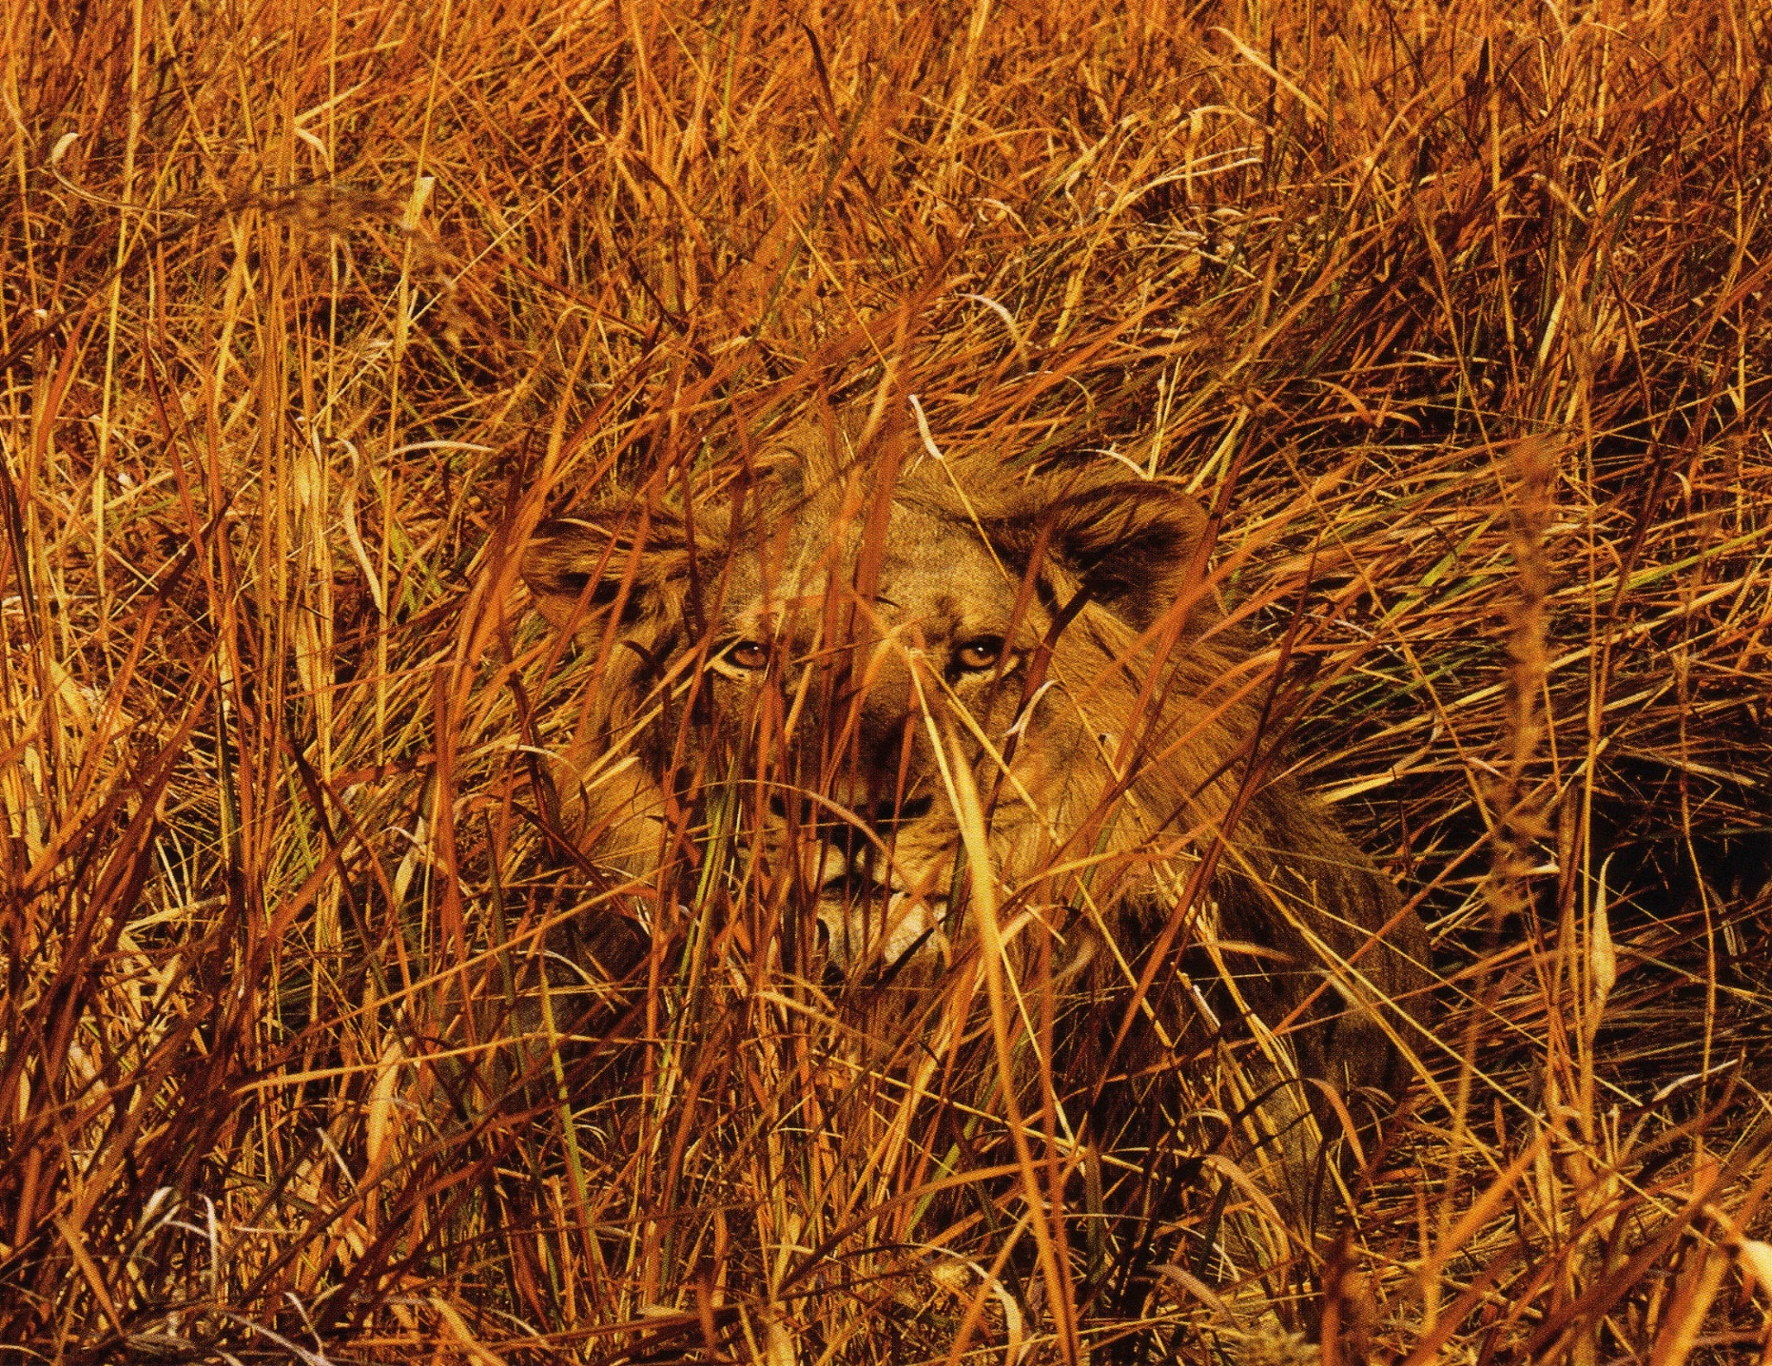
We can make it safely
Our eyes are open. We are alert.
We are watching for any who have fallen behind
We will not stop until we reach our destination

