Slide 1
Is It Still Possible to Be Simply Christians?

Slide 2
Are Christians commanded to be united?

Slide 3
Y^{es}
Paul commanded the Corinthians, “that you all speak the same thing, and that there be no divisions among you, but that you be perfectly joined together in the same mind and in the same judgment” (1 Cor. 1:10).

Slide 4
Does God ever command things that are impossible for us to do?

Slide 5
Nº
When God gave the Law to Israel, He made it clear that the commandment of the Law was “not too mysterious for you, nor is it far off” (Deut. 30:11)—it was near and accessible “that you may do it” (Deut. 30:14).

Slide 6
Nº
The same is true of the Law of Christ (cf. 1 Cor. 10:13).

Slide 7
Is God pleased with Christians being divided in doctrine and practice?

Slide 8
Nº
Jesus prayed that His disciples might be one (John 17:21), but He also warned them not to turn aside to false teaching (Matt. 7:15-20).

Slide 9
Can Christians depart from sound doctrine and still remain a part of Christ’s body?

Slide 10
Nº
Jesus warned individuals that those who do not bear fruit will be cut off from Him (John 15:5-6).

Slide 11
Nº
Jesus also warned churches unwilling to repent that they would be removed from His presence (Rev. 2:5).

Slide 12
Nº
John taught, “Whoever transgresses and does not abide in the doctrine of Christ does not have God. He who abides in the doctrine of Christ has both the Father and the Son” (2 John 9).

Slide 13
Is it ever necessary for Christians to separate themselves from those in error?

Slide 14
Y^{es}
The church is to withdraw from one who refuses to repent when rebuked for sin (Matt. 18:15-17).

Slide 15
Y^{es}
Withdrawal from the unrepentant is aimed at the restoration of one in error (1 Cor. 5:5) and to keep the church sound (1 Cor. 5:6-8).

Slide 16
Y^{es}
An unrepentant Christian from whom the church has withdrawn may still be considered a brother (2 Thess. 3:15), but he or she is not in an acceptable relationship with God.

Slide 17
Y^{es}
Christians must not “keep company with him that he may be ashamed” (2 Thess. 3:14).

Slide 18
Y^{es}
Those who have never come to Christ cannot be counted as brethren. We may seek to teach such a person (cf. Acts 18:24-26; 19:1-5)…

Slide 19
Y^{es}
… But one who expresses tolerance and acceptance of that which is outside of the doctrine of Christ “shares in his evil deeds” (2 John 10).

Slide 20
Does simply calling oneself a “Christian” truly identify him or her as a Christian?

Slide 21
Nº
Jesus said there would be those who would call Him “Lord” and yet by refusing to do His will be denied as His disciple on the Day of Judgment (Matt. 7:21-23).

Slide 22
Nº
It is the Bible not human beings that define who is and is not a Christian, or disciple of Christ (cf. Acts 11:26).

Slide 23
What determines whether an individual or group truly belongs to Christ?

Slide 24
Jesus said that abiding in His word determines if one is or is not His disciple (John 8:31).

Slide 25
What is a denomination?

Slide 26
In Latin the word nomen meant, “name.” This came into English in our word nominate, which means literally to “name” a person for a task or office.

Slide 27
The prefix de- when added to this word, either intensifies the primary meaning, or adds the sense of “away” from the thing named.

Slide 28
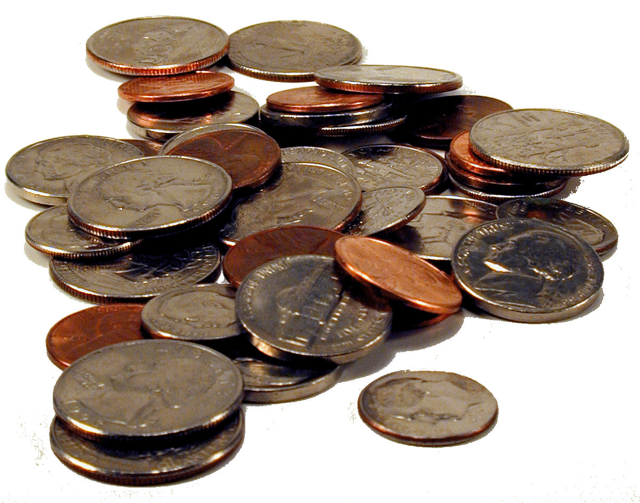
To denominate something is to distinguish it in name from something else.

Slide 29
Two things of a different “denomination” are not the same thing in nature or quality.

Slide 30
D^{enomination}
“A recognized autonomous branch of the Christian Church” (New Oxford American Dictionary).

Slide 31
D^{enomination}
Jesus told His disciples, “I am the vine, you are the branches” (John 15:5). The “branches” of the Lord’s church are individual disciples.

Slide 32
D^{enomination}
An individual is either part of Christ or outside of Christ. To be autonomous is “acting independently or having the freedom to do so” (New Oxford American Dictionary).

Slide 33
D^{enomination}
An individual cannot be autonomous. Paul declared, “I have been crucified with Christ; it is no longer I who live, but Christ lives in me” (Gal. 2:20).

Slide 34
D^{enomination}
Individuals have freewill, but we cannot act independently of Christ. Paul taught that Christians have become “slaves of God” (Rom. 6:22).

Slide 35
D^{enomination}
Groups of people are either part of Christ or outside of Christ. a. If they are a part of Christ they are the same in nature and identity.

Slide 36
D^{enomination}
When Jesus taught His disciples not to elevate disciples one over another, He explained, “you are all brethren” (Matt. 23:8).

Slide 37
D^{enomination}
We cannot denominate something from another thing and yet say it is the same in identity and nature.

Slide 38
The New Testament teaches no church government higher than the eldership of local congregations (Acts 14:23) and yet lower than the headship of Christ (Eph. 5:23).

Slide 39
One eldership does not rule over another church. In this sense congregations are autonomous, but even congregations must be in submission to the headship of Christ (Eph. 5:24).

Slide 40
If two congregations are different and distinct in practice or teaching, one (or both) is either obedient to God’s word or in rebellion to God’s word.

Slide 41
Individuals who are a part of that group are not, therefore, part of the church that belongs to Christ.

Slide 42
Is biblical unity accomplished by accepting unity in diversity?

Slide 43
Nº
Paul taught the same things “everywhere in every church” (1 Cor. 4:17).

Slide 44
Nº
The Bible teaches patience and respect for conscience (Rom. 15:1), but it also warns that one may “condemn himself” by approving of that which is wrong (Rom. 14:22).

Slide 45
Nº
Paul commanded the Romans, “Now I urge you, brethren, note those who cause divisions and offenses, contrary to the doctrine which you learned, and avoid them” (Rom. 16:17).

Slide 46
There are matters of judgment in which congregations have the liberty to choose different ways to fulfill the Lord’s commands.

Slide 47
The church is commanded to sing or speak to one another in “psalms and hymns and spiritual songs, singing and making melody in your heart to the Lord” (Eph. 5:19; cf. Col. 3:16)

Slide 48
We are not told how many songs, or what order in which those songs must fall during a time of worship.

Slide 49
We are not told whether the songs are to be in four-part harmony, or whether a congregation is to sing from a printed songbook or from a projection of the words and music.

Slide 50
If congregations differ in these matters of judgment it does not compromise their unity or their obedience to the word of God—they are still fulfilling the Lord’s instruction to sing or speak to one another in song.

Slide 51
if a congregation decides to add a mechanical instrument into their song worship the members of that congregation are adding an activity to this instruction that the Lord has not commanded.

Slide 52
To sing or speak is not the same activity as playing an instrument. The words of Scripture do not authorize this addition.

Slide 53
It is therefore a departure from Scripture that compromises abiding in the word of Christ (and therefore compromises unity between brethren).

Slide 54
If this unauthorized act is compelled upon a group of Christians it must be opposed and rejected.

Slide 55
If a group refuses to end this unscriptural act, a faithful Christian must remove himself from identification with such a congregation.

Slide 56
Can We Still Be Simply Christians?

Slide 57
Y^{es}
We can still be nothing more and nothing less that what Christians were in the New Testament!

Slide 58
If Not, What Are We Really Saying?

Slide 59
We cannot identify ourselves as “simply Christians.” we must be “Stone-Campbell Christians” or part of the “Church of Christ” denomination.

Slide 60
The Bible condemns party names whether those names represent respected brothers in Christ or not (1 Cor. 3:4).

Slide 61
The term “churches of Christ” (Rom. 16:16) is used in Scripture of congregations of the Lord’s people who are in a saved relationship with Him, but never of some segment of the church universal.

Slide 62
If it is not possible to be simply Christians without some denominational allegiance, we must accept that one can abide in Christ while failing to abide in His word!

Slide 63
Are denominations following the word of God?

Slide 64
Nº
They are divided in doctrine and practice and have adopted things that are outside of the word of Christ.

Slide 65
Nº
By definition a disciple of Christ abides in His word (John 8:31). One cannot have a relationship with God while stepping outside of the doctrine of Christ (2 John 9).

Slide 66
What About Grace?

Slide 67
It is clear that our salvation is not accomplished by our meritorious, and flawless ability to follow the Law of Christ…

Slide 68
… But by the merciful willingness of God to forgive our sin by His grace through the shed blood of Jesus Christ (Eph. 2:8).

Slide 69
All souls fall short of God’s glory (Rom. 3:23).

Slide 70
“All those things which you are commanded” are simply “what was our duty to do” (Luke 17:10).

Slide 71
Is God’s grace universal and automatic?

Slide 72
Nº
The soul outside of Christ will die in sin (John 8:24), and be condemned to hell. Paul said, “Through HIM [i.e. Jesus] we have received grace” (Rom. 1:5).

Slide 73
Nº
If one has not put on Christ in obedience to the gospel (Gal. 3:27), he or she is not yet a recipient of “the grace of God that brings salvation” (Titus 2:11).

Slide 74
What About People who are So Close?

Slide 75
The Bible speaks of those who are “not far from the kingdom of God” (Mark 12:34), but being close to the kingdom is not the same thing as being in or a part of the kingdom.

Slide 76
When Aquila and Priscilla learned that Apollos “spoke and taught accurately the things of the Lord” and yet “he knew only the baptism of John” (Acts 18:25)…

Slide 77
…Scripture tells us, “they took him aside and explained to him the way of God more accurately” (Acts 18:26).

Slide 78
Our task is to be “good stewards of the manifold grace of God” (1 Pet. 4:10), not to put ourselves in the place of God passing judgments He has not revealed!

