Slide 1
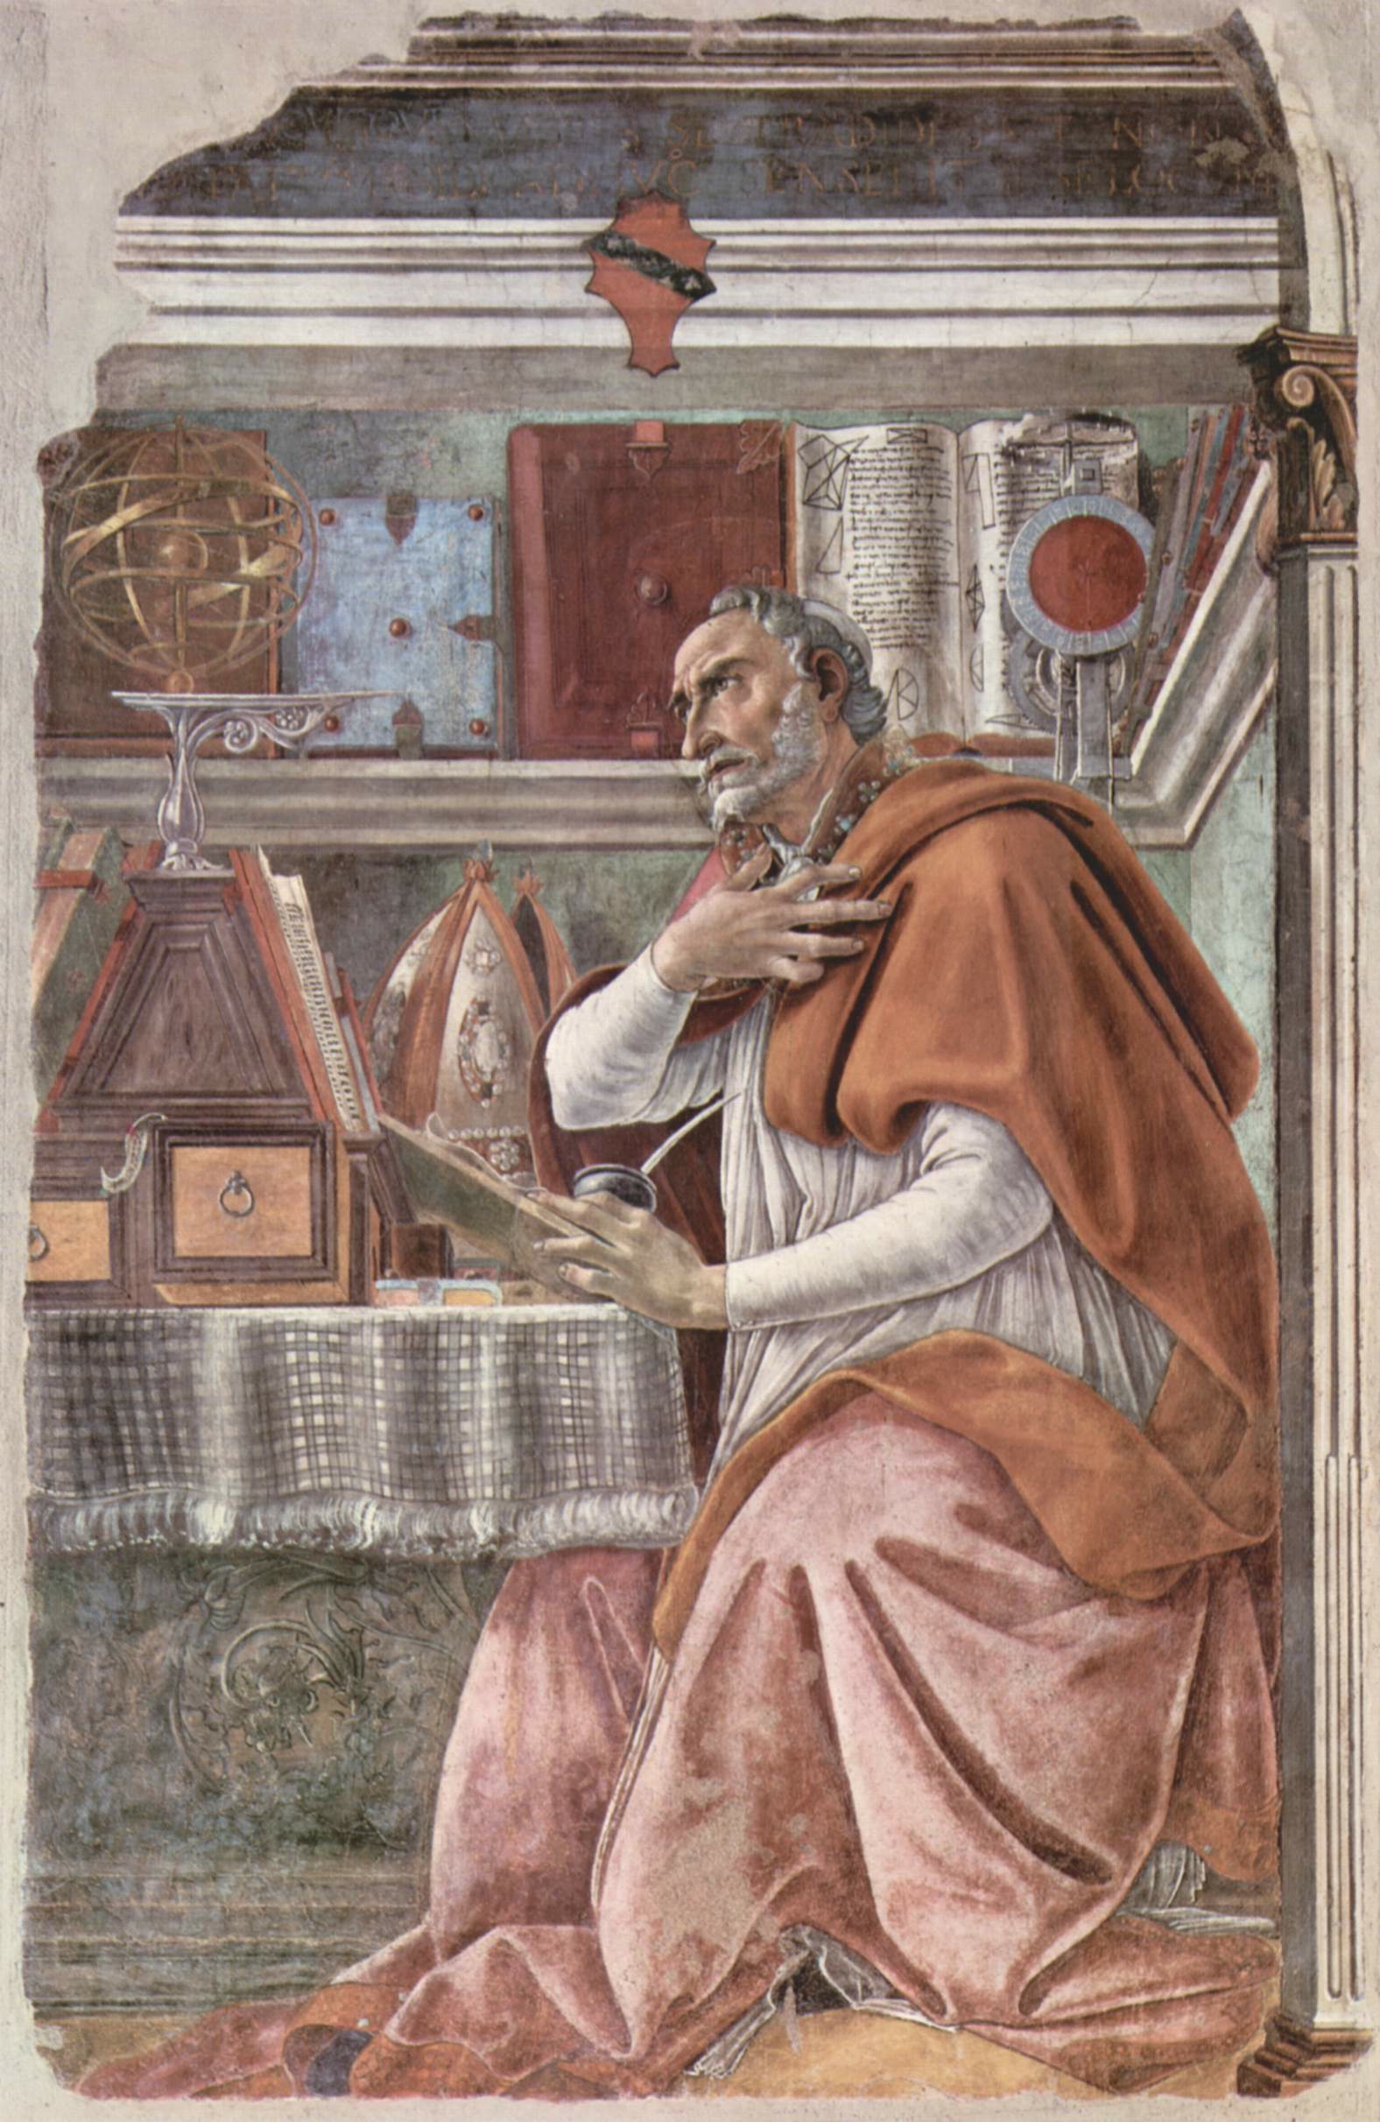
“Give me purity of body and self-control—but not now.”
~ Augustine of Hippo
Confessions 8.7
Augustine in His Study By Sandro, Botticelli
ca. 1480, in the Church of the Ognissanti, Florence. Italy.

Slide 2
The Nature of the Problem
We want to be what we should be (Jas. 3:2; Matt. 5:8; 1 Thess. 5:23).
But then we look at the world around us (Psa. 37:1-2; 73:2-7; Prov. 24:1-2; Heb. 11:25; 1 John 2:16-17a).

Slide 3
Some Say It’s Not the Right Time
“I’m not quite ready!” (Acts 24:25).
Temptations control us (Ecc. 1:8).

Slide 4
Some Aren’t Ready to Turn Away from Sin
They want to “sew their wild oats” while they are young (Ecc. 12:1).
We can become hardened to sin (Eph. 4:19; 1 Tim. 4:2; 1 Pet. 4:3).

Slide 5
Some Don’t Think They Are Ready
We should “count the cost” (Luke 14:28-33).
“Whoever of you does not forsake all that he has cannot be My disciple” (Luke 14:33).

Slide 6
Some Think They Still Have Time
Augustine’s prayer assumed he still had time to change (Luke 12:16-21).
None of us has this assurance—“This night your soul will be required of you.”

