Slide 1
CREATION
Beyond Genesis One

Slide 2
DAY ONE

Slide 3
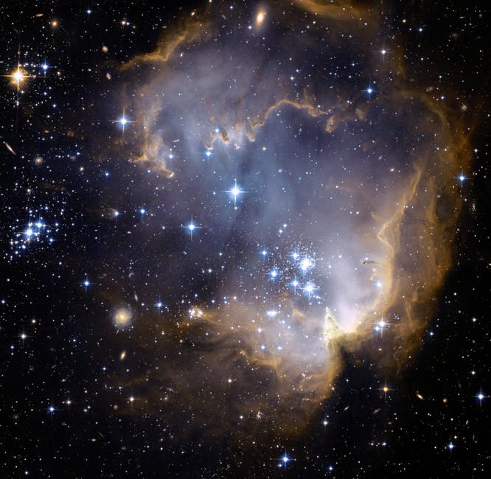
Genesis 1:1
“In the beginning God created the heavens and the earth. The earth was without form, and void; and darkness was on the face of the deep. And the Spirit of God was hovering over the face of the waters” (NKJV).

Slide 4
God Created All Things from Nothing
“By faith we understand that the worlds were framed by the word of God, so that the things which are seen were not made of things which are visible” (Heb. 11:3).

Slide 5
God Created All Things from Nothing
“…God, who gives life to the dead and calls those things which do not exist as though they did” (Rom. 4:17b).

Slide 6
He Made Everything Except Himself
“The great God who formed everything…” (Prov. 26:10a).

Slide 7
He Made Everything Except Himself
“You are worthy, O Lord, to receive glory and honor and power; for You created all things, and by Your will they exist and were created” (Rev. 4:11).

Slide 8
Jesus, God in the Flesh Created All Things
“In the beginning was the Word, and the Word was with God, and the Word was God. He was in the beginning with God. All things were made through Him, and without Him nothing was made that was made” (John 1:1-3).

Slide 9
Jesus, God in the Flesh Created All Things
“For by Him all things were created that are in heaven and that are on earth, visible and invisible, whether thrones or dominions or principalities or powers. All things were created through Him and for Him” (Col. 1:16).

Slide 10
Jesus, God in the Flesh Created All Things
“He was in the world, and the world was made through Him, and the world did not know Him” (John 1:10).

Slide 11
God Spoke All Things into Existence
“By faith we understand that the worlds were framed by the word of God…” (Heb. 11:3a).

Slide 12
God Spoke All Things into Existence
“By the word of the Lord the heavens were made, and all the host of them by the breath of His mouth. He gathers the waters of the sea together as a heap; He lays up the deep in storehouses…”

Slide 13
God Spoke All Things into Existence
“…Let all the earth fear the Lord; Let all the inhabitants of the world stand in awe of Him. For He spoke, and it was done; He commanded, and it stood fast.” (Ps. 33:6-9).

Slide 14
Genesis 1:3-5
“Then God said, ‘Let there be light’; and there was light. And God saw the light, that it was good; and God divided the light from the darkness. God called the light Day, and the darkness He called Night. So the evening and the morning were the first day”

Slide 15
God Created Light
“For it is the God who commanded light to shine out of darkness, who has shone in our hearts to give the light of the knowledge of the glory of God in the face of Jesus Christ” (2 Cor. 4:6).

Slide 16
God Created Light
“Where is the way to the dwelling of light? And darkness, where is its place, that you may take it to its territory, that you may know the paths to its home? Do you know it, because you were born then, or because the number of your days is great?” (Job 38:19-21).

Slide 17
God Created Light
“I form the light and create darkness…” (Isaiah 45:7a).

Slide 18
God Created Morning and Evening
“Have you commanded the morning since your days began, and caused the dawn to know its place?” (Job 38:12).

Slide 19
DAY TWO

Slide 20
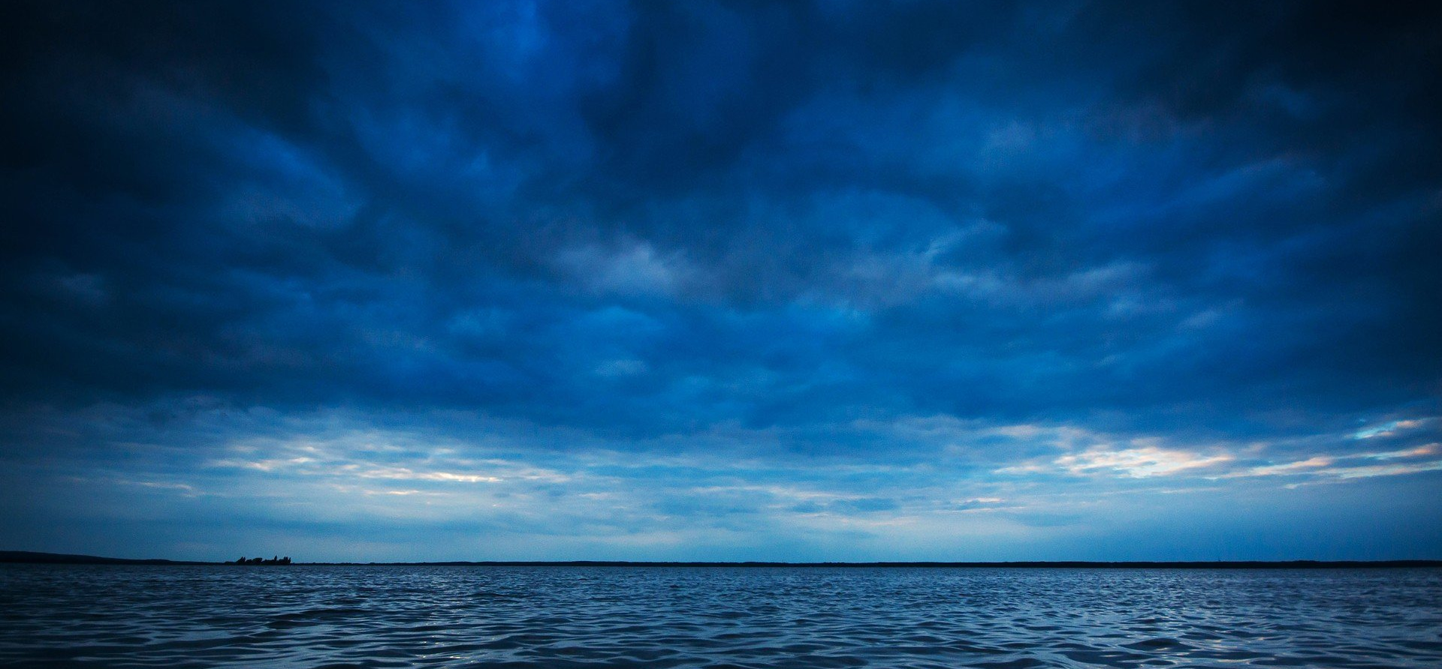
Genesis 1:6-8
“Then God said, ‘Let there be a firmament in the midst of the waters, and let it divide the waters from the waters.’ Thus God made the firmament, and divided the waters which were under the firmament from the waters which were above the firmament; and it was so. And God called the firmament Heaven. So the evening and the morning were the second day”

Slide 21
God Made Heavens and Earth
“…By the word of God the heavens were of old, and the earth standing out of water and in the water” (2 Pet. 3:5).

Slide 22
God Made Heavens and Earth
“Oh, give thanks to the God of gods! For His mercy endures forever. Oh, give thanks to the Lord of lords! For His mercy endures forever: To Him who alone does great wonders, For His mercy endures forever; To Him who by wisdom made the heavens, For His mercy endures forever; To Him who laid out the earth above the waters, For His mercy endures forever” (Psa. 136:2-6).

Slide 23
God Made Heavens and Earth
“By the word of the Lord the heavens were made, and all the host of them by the breath of His mouth” (Ps. 33:6).

Slide 24
God Made Heavens and Earth
“By His Spirit He adorned the heavens…” (Job 26:13a).

Slide 25
God Made Heavens and Earth
“The heavens declare the glory of God; and the firmament shows His handiwork. Day unto day utters speech, and night unto night reveals knowledge” (Psa. 19:1-2).

Slide 26
DAY THREE

Slide 27
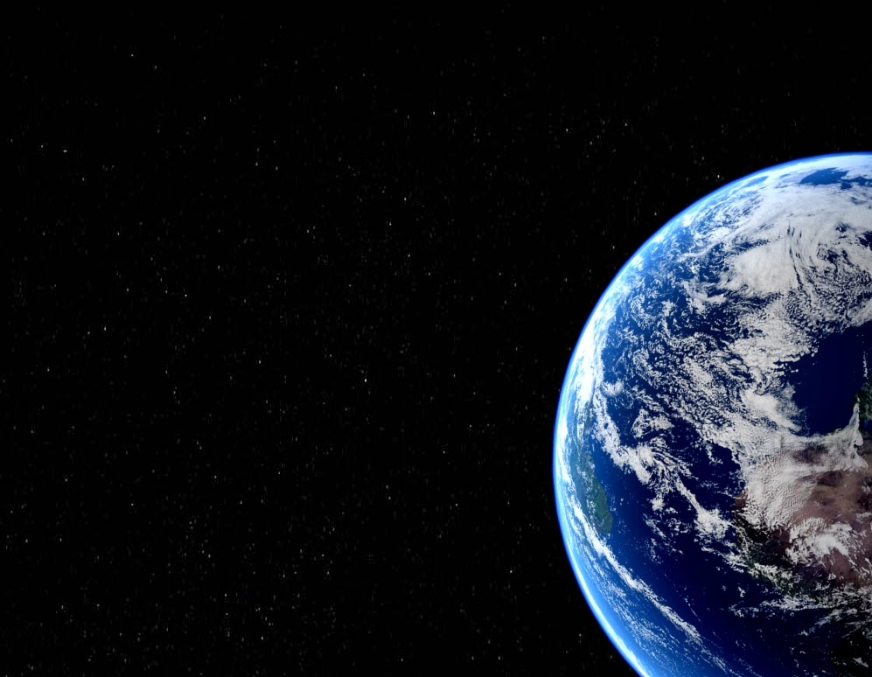
Genesis 1:9-13
“Then God said, ‘Let the waters under the heavens be gathered together into one place, and let the dry land appear’; and it was so. And God called the dry land Earth, and the gathering together of the waters He called Seas. And God saw that it was good. Then God said, ‘Let the earth bring forth grass, the herb that yields seed, and the fruit tree that yields fruit according to its kind, whose seed is in itself, on the earth’; and it was so…”

Slide 28
Genesis 1:9-13
“…And the earth brought forth grass, the herb that yields seed according to its kind, and the tree that yields fruit, whose seed is in itself according to its kind. And God saw that it was good. So the evening and the morning were the third day”

Slide 29
God Made the Earth and the Seas
“He stretches out the north over empty space; He hangs the earth on nothing” (Job 26:7).

Slide 30
God Made the Earth and the Seas
“Where were you when I laid the foundations of the earth? Tell Me, if you have understanding. Who determined its measurements? Surely you know! Or who stretched the line upon it? To what were its foundations fastened? Or who laid its cornerstone, when the morning stars sang together, and all the sons of God shouted for joy?” (Job 38:4-7).

Slide 31
God Made the Earth and the Seas
“Happy is he who has the God of Jacob for his help, whose hope is in the LORD his God, Who made heaven and earth, the sea, and all that is in them; Who keeps truth forever” (Psa. 146:5-6).

Slide 32
God Made the Plants of the Earth
“So why do you worry about clothing? Consider the lilies of the field, how they grow: they neither toil nor spin; and yet I say to you that even Solomon in all his glory was not arrayed like one of these. Now if God so clothes the grass of the field, which today is, and tomorrow is thrown into the oven, will He not much more clothe you, O you of little faith?” (Matt. 6:28-30).

Slide 33
He Is the Creator
“Therefore let those who suffer according to the will of God commit their souls to Him in doing good, as to a faithful Creator” (1 Pet. 4:14).

