Slide 1
Nothing New Under the Sun
Ecclesiastes 1:9
That which has been is that which will be, And that which has been done is that which will be done. So there is nothing new under the sun.

Slide 2
Nothing New Under the Sun
Noah
Genesis 6:13-14
¹³ Then God said to Noah, “The end of all flesh has come before Me; for the earth is filled with violence because of them; and behold, I am about to destroy them with the earth. ¹⁴ Make for yourself an ark of gopher wood; you shall make the ark with rooms, and shall cover it inside and out with pitch.

Slide 3
Nothing New Under the Sun
King Josiah
2 Kings 22:15-20
¹⁵ She said to them, “Thus says the Lord God of Israel, ‘Tell the man who sent you to me, ¹⁶ thus says the Lord, “Behold, I bring evil on this place and on its inhabitants, even all the words of the book which the king of Judah has read. ¹⁷ Because they have forsaken Me and have burned incense to other gods that they might provoke Me to anger with all the work of their hands, therefore My wrath burns against this place, and it shall not be quenched.”’

Slide 4
Nothing New Under the Sun
King Josiah
2 Kings 22:15-20 (continued)
¹⁸ But to the king of Judah who sent you to inquire of the Lord thus shall you say to him, ‘Thus says the Lord God of Israel, “Regarding the words which you have heard, ¹⁹ because your heart was tender and you humbled yourself before the Lord when you heard what I spoke against this place and against its inhabitants that they should become a desolation and a curse, and you have torn your clothes and wept before Me, I truly have heard you,” declares the Lord. ²⁰ “Therefore, behold, I will gather you to your fathers, and you will be gathered to your grave in peace, and your eyes will not see all the evil which I will bring on this place.”’” So they brought back word to the king.

Slide 5
Nothing New Under the Sun
Roman Emperor Constantine
4th Century
Vision
In Hoc Signo Vinces
(In This Sign You Will Conquer)

Slide 6
Nothing New Under the Sun
Roman Emperor Constantine
Symbol of a cross put on the armor of his army
Issued the Edict of Milan
Right to practice any religion
Formally recognized Christianity
Ended persecution of Christians
Adopted Christianity
Great apostasy

Slide 7
Nothing New Under the Sun
Protestant Reformation Movement
16th Century Europe
Luther, Calvin, Zwingli, Arminius
How?
Dark Ages
Crusades
Inquisitions
Printing Press

Slide 8
Nothing New Under the Sun
Restoration Movement
19th Century
Denominationalism/Division rampant
Barton W. Stone, Thomas & Alexander Campbell, and Walter Scott
“We shall speak where the Bible speaks, we shall be silent where the Bible is silent.” - Thomas Campbell

Slide 9
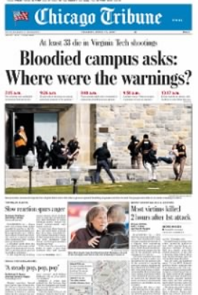
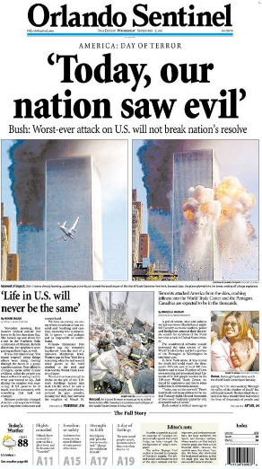
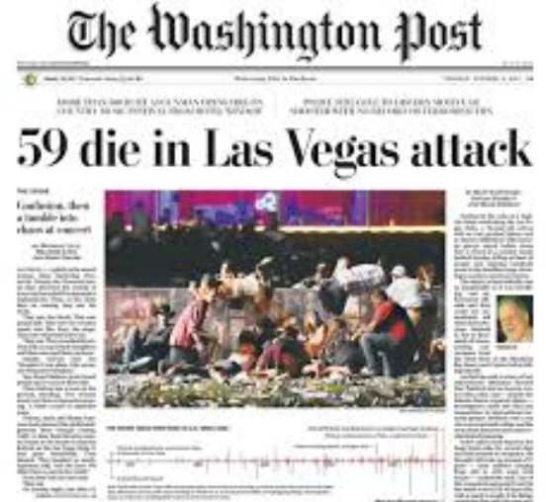
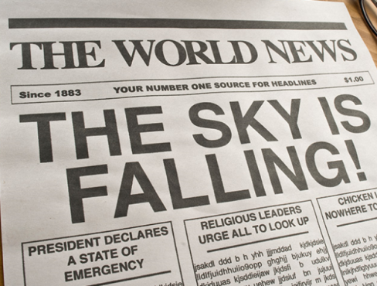
Nothing New Under the Sun
Today

Slide 10
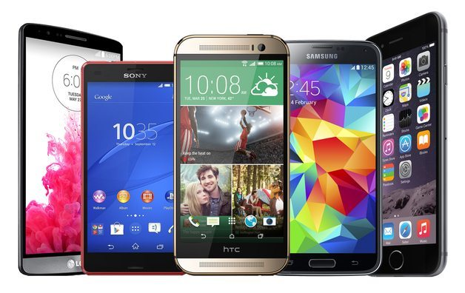
Nothing New Under the Sun
Today
Truth?

Slide 11
Nothing New Under the Sun
Simplicity
Do Good
Galatians 6:10 So then, as we have opportunity, let us do good to everyone, and especially to those who are of the household of faith.
Believe
John 3:16 “For God so loved the world, that he gave his only Son, that whoever believes in him should not perish but have eternal life.
Confess
1 John 1:9 If we confess our sins, he is faithful and just to forgive us our sins and to cleanse us from all unrighteousness.
Romans 10:9 Because, if you confess with your mouth that Jesus is Lord and believe in your heart that God raised him from the dead, you will be saved.
Repent and be Baptized
Acts 2:38 And Peter said to them, “Repent and be baptized every one of you in the name of Jesus Christ for the forgiveness of your sins, and you will receive the gift of the Holy Spirit.
Trust and Obey
Hebrews 13:5-6 Keep your life free from love of money, and be content with what you have, for he has said, “I will never leave you nor forsake you.” So we can confidently say, “The Lord is my helper; I will not fear; what can man do to me?”
John 14:15 “If you love me, you will keep my commandments.

Slide 12
Nothing New Under the Sun
Example/Reputation
Colossians 3:17 And whatever you do, in word or deed, do everything in the name of the Lord Jesus, giving thanks to God the Father through him.
Matthew 18:6 But whoever causes one of these little ones who believe in me to sin, it would be better for him to have a great millstone fastened around his neck and to be drowned in the depth of the sea.
James 1:27 Religion that is pure and undefiled before God, the Father, is this: to visit orphans and widows in their affliction, and to keep oneself unstained from the world.
Matthew 5:16 In the same way, let your light shine before others, so that they may see your good works and give glory to your Father who is in heaven.
1 Corinthians 15:33 Do not be deceived: “Bad company ruins good morals.”
James 4:17 So whoever knows the right thing to do and fails to do it, for him it is sin.
Romans 12:2 Do not be conformed to this world, but be transformed by the renewal of your mind, that by testing you may discern what is the will of God, what is good and acceptable and perfect.
2 Corinthians 5:10 For we must all appear before the judgment seat of Christ, so that each one may receive what is due for what he has done in the body, whether good or evil.
Titus 2:7 Show yourself in all respects to be a model of good works, and in your teaching show integrity, dignity,

