Slide 1
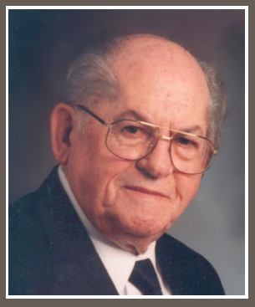
Respected Book
First published in 1959
H.E. Phillips
(Gospel Preacher)

Slide 2
DUTIES OF THE CHURCH TOWARD THE ELDERS
Chapter 12

Slide 3
1
Know the Elders
1 Thessalonians 5:12
“Recognize” (NKJV)
“Appreciate” (NASB)
“Respect” (NIV)
Gr. eidō or oida, lit. “see; know”

Slide 4
2
Esteem the Elders Highly in Love
1 Thessalonians 5:13a
“Very Highly”
“In Love”
“For their work’s sake” (cf. Heb. 13:17)

Slide 5
3
Be at Peace with One Another
1 Thessalonians 5:13b
“Let them do so with joy and not with grief” (Heb. 13:17c)

Slide 6
4
Obey the Elders
Hebrews 13:17a
Responsibility in many relationships (Titus 3:1; 2:5; Eph. 6:1; Col. 3:22)
God takes priority (Acts 5:29)

Slide 7
5
Submit to the Elders
Hebrews 13:17b
Gr. hupeikō lit. “to yield under”
To one another (1 Pet. 5:5)

Slide 8
6
Remember and Imitate the Elders
Hebrews 13:7
“Imitate their faith” (ASV, NASB, NIV, ESV)
“Examples to the flock” (1 Pet. 5:3)

Slide 9
7
Do Not Rebuke Elders, but Admonish Exhort as a Father
1 Timothy 5:1
“Intreat” (KJV); “appeal” (NASB)
Gr. parakaleō “to call to one’s side”

Slide 10
8
Do Not Receive an Accusation against an Elder except from Two or Three Witnesses
1 Timothy 5:19

Slide 11
9
Call the Elders When in Need
James 5:14
Elders can’t help what they do not know
We must not sit and wait

