Slide 1
Defending the Authority of God

Slide 2
“Whatever you do in word or deed, do all in the name of the Lord Jesus, giving thanks through Him to God the Father.”
(Colossians 3:17)

Slide 3
The Sovereign Authority of God
“Those who contend with the LORD will be shattered; against them He will thunder in the heavens, the LORD will judge the ends of the earth; and He will give strength to His king, and he will exalt the horn of His anointed”
(I Sam. 2:10).

Slide 4
The Sovereign Authority of God
“He said, ‘O LORD, the God of our fathers, are you not God in the heavens? And are you not ruler over all the kingdoms of the nations? Power and might are in your hand so that no one can stand against You.’”
(2 Chronicles 20:6;
I Chronicles 29:10-13).

Slide 5
The Sovereign Authority of God
"Woe to the one who quarrels with his Maker - An earthenware vessel among the vessels of earth! Will the clay say to the potter, 'What are you doing?' Or the thing you are making say, 'He has no hands'? "Woe to him who says to a father, 'What are you begetting?' Or to a woman, 'To what are you giving birth?'"
(Isaiah 45:9-10).

Slide 6
The Sovereign Authority of God
“So in the present case, I say to you, stay away from these men and let them alone, for if this plan or action is of men, it will be overthrown; but if it is of God, you will not be able to overthrow them; or else you may even be found fighting against God”
(Acts 5:38-39).

Slide 7
The Sovereign Authority of God
“Let the heavens be glad, and let the earth rejoice; and let them say among the nations, ‘The Lord reigns’” (I Chron. 16:31).
"Worthy are You, our Lord and our God, to receive glory and honor and power; for You created all things, and because of Your will they existed, and were created” (Rev. 4:11).

Slide 8
The Sovereign Authority of God
“The LORD reigns, He is clothed with majesty; The LORD has clothed and girded Himself with strength; Indeed, the world is firmly established, it will not be moved” (Psalm 93:1).
“It is He who sits above the circle of the earth, And its inhabitants are like grasshoppers, Who stretches out the heavens like a curtain And spreads them out like a tent to dwell in” (Isaiah 40:22).
“Instead, you ought to say, ‘If the Lord wills, we will live and also do this or that’” (James 4:15).

Slide 9
“Turn to Me and be saved, all the ends of the earth; for I am God, and there is no other. I have sworn by Myself, the word has gone forth from My mouth in righteousness and will not turn back, that to Me every knee will bow, every tongue will swear allegiance”
(Isaiah 45:22, 23).
“For this reason also, God highly exalted Him, and bestowed on Him the name which is above every name, so that at the name of Jesus every knee will bow, of those who are in heaven and on earth and under the earth, and that every tongue will confess that Jesus Christ is Lord, to the glory of the Father”
(Philippians 2:9-11).
The Sovereignty of Jesus Christ

Slide 10
The Sovereign Authority of God
God has every right to command His people.
God’s sovereignty is reverenced when we:
Understand his will (Ephesians 3:3-5; 5:17).
Live in His purpose (Ephesians 1:6, 12, 14).
Commit our hearts to the revelation of the gospel (I Cor. 2:9-16).

Slide 11
Faith & Authority
The Faith of the Centurion (Matt. 8:5-13).
Jesus and the Centurion’s discussion the nature of authority and Jesus’ power (8:8-9).
Trusting in Jesus is trusting that He has all authority (Matthew 28:18).
When Jesus evaluated their conversation about authority he did not say, “I have not found a man in all of Israel with such a great grasp of authority” – He said, “I have not found in Israel such great faith.”

Slide 12
Love of God & Authority
What is our definition of love?
To preach the love of God is to preach the perfect example of Jesus (Hebrews 5:8-9).
To preach the love of God is to preach an obedient faith (John 14:15; John 15:14; I John 5:3).
To preach about our need to love God with our whole heart is to preach about sacrificial discipleship (Matt. 10:32-39).

Slide 13
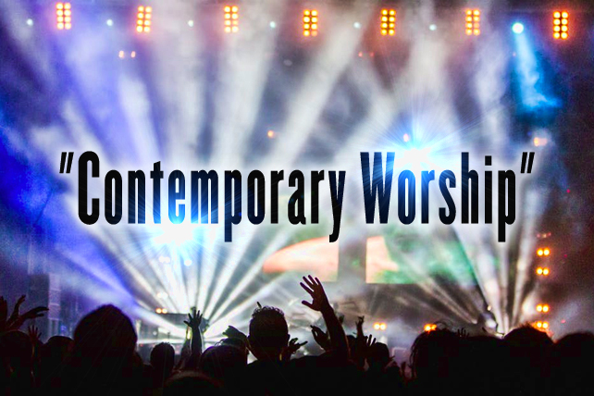
Holy Praise & Authority
God-centered worship is concerned about Biblical authority.
Man centered worship is concerned about what “I” want.

Slide 14
“What comes into our mind when we think about God is the most important thing to us…the history of mankind will probably show that no people has ever risen above its religion and man’s history will positively demonstrate that no religion has ever been greater than its idea of God. Worship is pure or base as the worshipper entertains high or low thoughts of God…Were we able to extract from any man a complete answer to the question, ‘What comes into your mind when you think about God?’ we might predict with certainty the spiritual future of that man”
(Repring; New York: Harper & Row, 1975, 9).

Slide 15
Victoria Osteen, “I want to encourage every one of us to realize that when we obey God, we are not doing it for God, I mean that is one way to look at it. We are doing it for ourselves… so I want you to know this morning just do good for your own self … when you come to … worship you are not doing it for God, you are doing it for your self…Amen.”

Slide 16
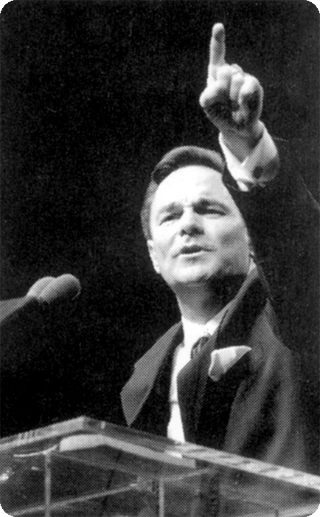
The carnal view of many “religious people” is completely out of hand: “A number of Baptist bloggers who opposed Floyd linked to articles by the Associated Baptist Press about the church’s children ministry and a ‘fire truck’ baptistery. One article quoting Christianity Today, said, ‘The unique baptistery, created by Disney designer Bruce Barry, is part of a $270,000 high tech project for the church’s children worship area which includes…

Slide 17
“…video games, a light show, music videos and a bubble machine, according to Christianity Today. When a child is baptized in the fire-truck baptistery, sirens blare and confetti is fired out of cannons. ‘Putting a talking head in front of kids for an hour does not work,’ the children’s minister told the magazine…Floyd told Arkansas Baptist News that creative evangelism was needed to package the gospel ‘in ways the culture can understand and receive’” (Arkansas Times, p.4).

Slide 18
Our Identity In Christ
Confession
Proclamation
Fellowship

