Slide 1
The AD 70 Doctrine PART FOUR
In July Olsen Park will host a debate
Holger Neubauer & Bruce Reeves
“Will Jesus Really Come Again?”
Before this the elders have asked me to do some lessons to familiarize us with this this unusual doctrine

Slide 2
Is This Really Such a Big Deal?
Jesus won’t return
No Judgment Day
No bodily resurrection
All has been fulfilled
Souls don’t go to Hades
Mosaic Law continued after the cross
Jews and Gentiles remained separate
Eternal salvation came in AD 70

Slide 3
Is This Really Such a Big Deal?
Embraced by good Bible students
Viewed as an evolution in their faith
Consider it to better harmonize Scripture
Consider it a further restoration

Slide 4
Is This Really Such a Big Deal?
325 miles southeast is the city of Weatherford, Texas
Some years ago this issue led to a split in a church there resulting in the formation of a new congregation.

Slide 10
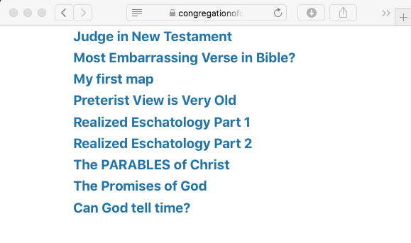

Slide 12
Is This Really Such a Big Deal?
Don K. Preston
“. . . It is an extensive treatment of ALL of Israel’s promises concerning her hope of restoration under Messiah . . . . it should be seen as the uncovering of the eternal purpose of God. It affects an extensive range of biblical doctrines. . .”

Slide 13
Is This Really Such a Big Deal?
Don K. Preston
“. . . and promises, and sees the NT as being the announcement, warning, and prompting concerning the fulfillment of those promises.”
“Why the Study of Covenant Eschatology is Important,” November 28, 2012, https://bibleprophecy.com/blog/2012/11/28/why-the-study-of-covenant-eschatology-is-important-guest-article/

Slide 14
The AD 70 Doctrine FOUR FLAWED ASSUMPTIONS
1. Narrow interpretations of ALL time statements
2. Figurative interpretations of ALL apocalyptic language
3. Mount of Olives discourse is ONLY about the destruction of Jerusalem
4. An EARLY date of Book of Revelation

Slide 15
The AD 70 Doctrine FOUR FLAWED ASSUMPTIONS
All of these assumptions must be correct for this doctrine to stand.

Slide 16
The AD 70 Doctrine FOUR FLAWED ASSUMPTIONS
If any of these assumptions are incorrect this doctrine collapses.

Slide 18
The AD 70 Doctrine HISTORY
Justin Martyr
(mid-2nd century)
“For if you have fallen in with some who are called Christians, but who do not admit this [truth], and venture to blaspheme the God of Abraham, and the God of Isaac, and the God of Jacob; who say there is no resurrection. . .”

Slide 19
The AD 70 Doctrine HISTORY
Justin Martyr
(mid-2nd century)
“. . . of the dead, and that their souls, when they die, are taken to heaven; do not imagine that they are Christians. . . (Dialogue with Trypho 80).
So, yes, some believed elements of this but they were not considered sound in faith.

Slide 20
The AD 70 Doctrine HISTORY
Melito of Sardis
(mid-2nd century)
“Destroyed death” and “trampled Hades underfoot” thus “carried off man to the heights of heaven” (On Passover 102; cf. Eph. 2:6).
But speaks of resurrection as a future event (“He will raise you up” ibid. 103).

Slide 21
The AD 70 Doctrine HISTORY
Melito of Sardis
(mid-2nd century)
Saw man as “divided up into parts by death” (i.e. body/soul—ibid. 55-56) from which he saw Christ as accomplishing a reconciliation—He “sealed our souls by His own spirit and the members of our bodies by His own blood” (ibid. 67).

Slide 22
The AD 70 Doctrine HISTORY
Melito of Sardis
(mid-2nd century)
Did not see OT language as the reality. Of OT generally—“every event and speech involves a pattern–that which is spoken, a pattern, and that which happens, a prefiguration–in order that as the event is disclosed through the prefiguration, so also the speech may be brought to expression through its outline” (ibid. 35)

Slide 23
The AD 70 Doctrine HISTORY
Tertullian
(ca. AD 160-225)
“For Daniel says, that ‘both the holy city and the holy place are exterminated together with the coming Leader’. . . in order that we may believe all to have been as well fulfilled as foreseen” (An Answer to the Jews 8).

Slide 24
The AD 70 Doctrine HISTORY
Tertullian
(ca. AD 160-225)
In context, he is talking to Jews about Christ’s first coming. This is clear from the same text where he identifies this as Christ’s “first advent” in contrast to His future “second advent” when He will come “on the clouds” in “glory and honor” (ibid. 14).

Slide 25
The AD 70 Doctrine HISTORY
Tertullian
(ca. AD 160-225)
He believed, “All souls, therefore, are shut up within Hades. . . the soul undergoes punishment and consolation in Hades in the interval, while it awaits its alternative of judgment, in a certain anticipation either of gloom or of glory. . .” (A Treatise on the Soul 48).

Slide 26
The AD 70 Doctrine HISTORY
Tertullian
(ca. AD 160-225)
He applied Daniel 7:13-14 (“son of Man coming with the clouds”) to Christ’s “second advent,” arguing that the OT prophesied a humble and a glorious coming of Christ—the Jews “to this day they deny that their Christ has come, because He has not appeared in majesty, while they ignore the fact that He was to come also in lowliness” (Against Marcion 3.7)

Slide 27
The AD 70 Doctrine HISTORY
Eusebius of Caesarea
(AD 260-340, Church Historian)
“. . .The End of all things (so foretold) should be at hand, and be fully brought to pass : in these days should be fulfilled all that had been spoken of Christ (and of His church) by the prophets” (Extract from Theophania)
As quoted by Congregation of Christ at Weatherford (https://congregationofchrist.org/preterist-view-is-very-old/)

Slide 28
The AD 70 Doctrine HISTORY
Eusebius of Caesarea
(AD 260-340, Church Historian)
This is actually a quote from the “Preliminary Dissertation” of a translation of Eusebius’s Theophania, written by Preterist Samuel Lee (Cambridge: University Press, 1843, cli)—These are not the words of Eusebius!

Slide 29
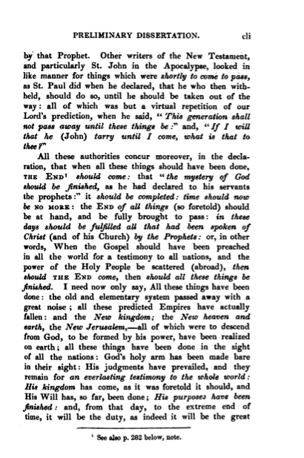
The AD 70 Doctrine HISTORY
Eusebius of Caesarea
(AD 260-340, Church Historian)
Original book may be accessed on Google Books: https://books.google.com/books?id=yZdeAAAAcAAJ&pg=PR103&lpg=PR103&dq=Eusebius+Theophania+%22end+of+all+things%22&source=bl&ots=YenSl7ZSFt&sig=ACfU3U1XBr_M_8i95xufr8SnWIKLed3O7Q&hl=en&sa=X&ved=2ahUKEwiYvuq7vY3qAhUMXa0KHS2SCWUQ6AEwAHoECAoQAQ#v=onepage&q=Eusebius%20Theophania%20%22end%20of%20all%20things%22&f=false

Slide 30
The AD 70 Doctrine HISTORY
Eusebius of Caesarea
(AD 260-340, Church Historian)
“The Holy Scriptures foretell that there will be unmistakable signs of the Coming of Christ. Now there were among the Hebrews three outstanding offices of dignity, which made the nation famous, firstly the kingship. . .”
Congregation of Christ at Weatherford (https://congregationofchrist.org/preterist-view-is-very-old/)

Slide 31
The AD 70 Doctrine HISTORY
Eusebius of Caesarea
(AD 260-340, Church Historian)
“. . .secondly that of prophet, and lastly the high priesthood. The prophecies said that the abolition and complete destruction of all these three together would be the sign of the presence (parousia) of the Christ” (Demonstratio Evangelica 8.363)
(https://congregationofchrist.org/preterist-view-is-very-old/)

Slide 32
The AD 70 Doctrine HISTORY
Eusebius of Caesarea
(AD 260-340, Church Historian)
In the context he is talking about Jesus’s first parousia, and arguing that the end of kingship, prophecy, and priesthood proved He was the Messiah.
He was not discussing Christ’s Second parousia.

Slide 33
The AD 70 Doctrine HISTORY
Hegesippus
(2nd Century Church Historian)
Quoted by Eusebius, regarding death of James: “He himself sits in heaven at the right hand of the great Power, and is about (mellō) to come upon the clouds of heaven” (Ecclesiastical History 2.23.3, 13).

Slide 34
The AD 70 Doctrine HISTORY
Hegesippus
(2nd Century Church Historian)
Parallels Matthew 16:27 (mellō) and Christ’s words t Caiaphas (Matt. 26:64).
Relies on mellō argument (cf. 2 Pet. 2:6; Heb. 11:20—long timeframe)
Assumes what it claims to prove.

Slide 35
The AD 70 Doctrine HISTORY
Hegesippus
(2nd Century Church Historian)
Fails to recognize that he also quotes him to says that Domitian (long after AD 70) “feared the coming (parousia) of Christ as Herod also had feared it” (ibid. 3.19-20.2).

Slide 36
The AD 70 Doctrine HISTORY
Hegesippus
(2nd Century Church Historian)
He further quotes him to say relatives of Jesus were brought before Domitian declaring Christ’s kingdom, “was not a temporal nor an earthly kingdom, but a heavenly and angelic one, which would appear at the end of the world (sunteleia tou aiōnos, cf. Matt. 24:3, 13:49; 28:20). . .”

Slide 37
The AD 70 Doctrine HISTORY
Hegesippus
(2nd Century Church Historian)
“. . . when he should come in glory to judge the quick and the dead, and to give unto every one according to his works” (ibid. 3.20.6).
This does not support full preterism!

Slide 38
The AD 70 Doctrine HISTORY
Odes of Solomon
(42 early songs written by an unknown Christian)
Speak of salvation in present language
“I put on immortality through His name, and took off corruption by His grace” (15.8)
“. . . Eternal life has arisen in the Lord’s land, and it has been declared to His faithful ones, and has been given without limit to all that trust in Him” (15.10)

Slide 39
The AD 70 Doctrine HISTORY
Odes of Solomon
(42 early songs written by an unknown Christian)
The New Testament does the same
“These things I have written to you who believe in the name of the Son of God, that you may know that you have eternal life, and that you may continue to believe in the name of the Son of God” (1 John 5:13)

Slide 40
The AD 70 Doctrine HISTORY
Odes of Solomon
(42 early songs written by an unknown Christian)
The New Testament does the same
“. . . Jesus Christ, who has abolished death and brought life and immortality to light through the gospel” (2 Tim. 1:10)
Yet, Ode 6.4 still speaks of a time it calls "the end."

Slide 41
The AD 70 Doctrine HISTORY
Odes of Solomon
(42 early songs written by an unknown Christian)
Ode 9.11 speaks of the time when “all those who have conquered will be inscribed in His book.”
Ode 33.11 speaks of a time when the faithful “will be saved” with the Lord declaring “I am your judge.”
Ode 14.5 prays “let me be saved from the Evil One.”

Slide 42
The AD 70 Doctrine HISTORY
Odes of Solomon
(42 early songs written by an unknown Christian)
“Death has been destroyed before my face, and Sheol has been vanquished by my word” (15.9)
It says of Jesus in His death “Sheol saw me and was shattered, and Death ejected me and many with me” (42.11)
Yet it speaks of Sheol as still in existence.

Slide 43
The AD 70 Doctrine HISTORY
None of These Represent a Belief in Full-Preterism!
At Best They Demonstrate Elements of Partial Preterism.

Slide 44
The AD 70 Doctrine HISTORY
Luis del Alcázar
(1554–1613, Jesuit Theologian)
To counter the Protestant interpretation of Catholicism as the beast of Revelation, he applied it to Roman persecution of the church in the first six centuries.

Slide 45
The AD 70 Doctrine HISTORY
Hugo Grotius
(1583–1645, Dutch Commentator)
First Protestant to argue that texts referring to the beast, man of sin, and antichrist had 1st century fulfillment.
Later made moderate preterist interpretations of Revelation and Olivet Discourse.

Slide 46
The AD 70 Doctrine HISTORY
Others Took Views Similar to Alcázar and Grotius.
None Yet Advocated Full-Preterism.

Slide 47
The AD 70 Doctrine HISTORY
Firmin Abauzit
(1679–1767, French Librarian)
Wrote first known Full-Preterist exposition of Revelation.
Recanted his position after critical examination by his English translator Leonard Twells and tried unsuccessfully to stop its reprint.

Slide 48
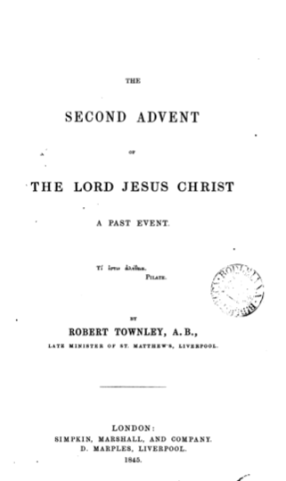
The AD 70 Doctrine HISTORY
Robert Townley
(1843)
Wrote first known American Full-Preterist book—The Second Advent of the Lord Jesus Christ: A Past Event.
He became a Universalist minister and in 1852 recanted his position.

Slide 49
The AD 70 Doctrine HISTORY
Former Full-Preterist Todd Dennis has demonstrated a clear early connection between Universalism and Full-Preterism

Slide 50
The AD 70 Doctrine HISTORY
Benjamin Franklin
(1812-1878, Restoration Preacher)
Devoted five pages to refuting the argument that Christ came in AD 70 associating it with Universalism.
In “The Second Coming of Christ and the Destruction of the World,” 435-440, The Gospel Preacher: A Book of Twenty-One Sermons, Vol. 1, Cincinnati: Franklin & Rice Publishers, 1st Ed., 1869.

Slide 51
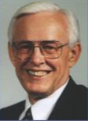
The AD 70 Doctrine HISTORY
Max R. King
(1930-present)
In 1971 he published The Spirit of Prophecy, advocating full-preterism.
His teaching among churches of Christ created division in the Ohio area.

Slide 52
The AD 70 Doctrine HISTORY
In the years since then other preachers among churches of Christ also began teaching full-preterism (Don Preston, Holger Neubauer).
In the early 2000s, King and his sons adopted universalism.
The movement has divided over universalism and corporate vs. individual body resurrection concepts.

Slide 53
The AD 70 Doctrine
Why Does It Matter?
Paul warned Timothy, “not to strive about words to no profit, to the ruin of the hearers” (2 Tim. 2:14).
What Difference Does It Make?

Slide 54
The AD 70 Doctrine
It Changes How We View Scripture
Paul said we understand Scripture simply by reading (Eph. 3:4).
Jesus said the truth is often hidden to the “wise and prudent” but revealed to “babes” (Luke 10:21).

Slide 55
The AD 70 Doctrine
It Changes How We View Scripture
This is a difficult doctrine that assumes that you cannot understand simple statements in Scripture without an in-depth background of connecting Scripture with Scripture from diverse and distant contexts.

Slide 56
The AD 70 Doctrine
It Changes How We View Scripture
Certainly, there are “milk” and “meat” doctrines in Scripture (Heb. 5:12-14)
There are things “hard to understand” (2 Pet14-16).
This doctrine makes all Scripture difficult.

Slide 57
The AD 70 Doctrine
It Changes How We View Fundamental Doctrines.
Doctrines such as expectation of a final judgment, a hope of heaven with no tears, no death, and no pain, and a belief that Jesus will actually return some time in the future are altered or completely rejected.

Slide 58
The AD 70 Doctrine
It Changes How We View Fundamental Doctrines.
These are elementary principles (Heb. 6:1-3).
To reject them is to reject the Gospel.
To misunderstand them is to misunderstand the Gospel.

Slide 59
The AD 70 Doctrine
It Changes How We View Fellowship.
“Preterist” Churches—Denominational Tolerance
Non-Preterist Churches—Ignorant and apostate
All of the Doctrine of Christ Determines Fellowship (2 John 9-11)

Slide 60
The AD 70 Doctrine
It Causes Division.
If something is true we must obey God rather than men (Acts 5:29).
If it is not—if it is opinion or speculation—we must not allow it to cause division (1 Cor. 1:10).
May we hold faithfully to God’s word and stand firmly against all error and falsehood.

