Slide 1
Choosing a Bible Translation
Why Do Translations Differ?
Differences in language
A different textual basis

Slide 2
Choosing a Bible Translation
NT Textual Basis
“Received Text”
Textus Receptus / “Majority Text”
“Critical Texts”
Relying on Modern Discoveries

Slide 3
Choosing a Bible Translation
How We Got the Bible
2007 Sermon Series
How the Bible Came to Us
2016-17 Bulletin Series
www.olsenpark.com

Slide 4
Choosing a Bible Translation
Why Do Translations Differ?
Differences in language
A different textual basis
Different doctrinal perspectives
Style of translation

Slide 5
Choosing a Bible Translation
Different Styles of Translation
The Paraphrase
The Interlinear
“Dynamic Equivalence”
“Formal Equivalence”

Slide 6
Choosing a Bible Translation
3. “Dynamic Equivalence” Thought-for-thought

Slide 7
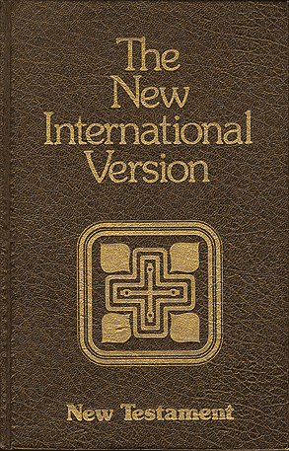
Choosing a Bible Translation
New International Version
International Bible Society. Grand Rapids: Zondervan, 1978
Romans 8:5
“Those who live according to the sinful nature have their minds set on what that nature desires...”
Gr. sarx means simply “flesh.”
Jesus had the same sarx we do (Heb. 2:14).

Slide 8
Choosing a Bible Translation
New International Version
Psalm 51:5
“Surely I was sinful at birth, sinful from the time my mother conceived me.”
Blatant Calvinism!
2011 edition “sinful nature > flesh” kept “sinful at birth”

Slide 9
Choosing a Bible Translation
New International Version
Psalm 8:4
“What is man that you are mindful of him, the son of man that you care for him?”
“Gender-Inclusive” Issues

Slide 10
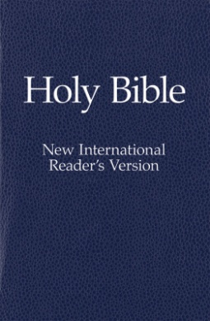
Choosing a Bible Translation
New International Readers Version
International Bible Society. Grand Rapids: Zondervan, 1994
Psalm 8:4
“What is a human being that you think about him? What is a son of man that you take care of him?”

Slide 11
Choosing a Bible Translation
Today’s New International Version International Bible Society. Grand Rapids: Zondervan, 2005
Psalm 8:4
“What are mere mortals that you are mindful of them, human beings that you care for them?”

Slide 12
Choosing a Bible Translation
“Five Negative Effects of Dynamic Equivalence”
Taking Liberties in Translation;
Destabilization of the Text;
What the Bible “Means” vs. What the Bible Says;

Slide 13
Choosing a Bible Translation
“Five Negative Effects of Dynamic Equivalence”
Falling Short of What We Should Expect;
A Logical and Linguistic Impossibility.
– Leland Ryken, Choosing A Translation

Slide 14
Choosing a Bible Translation
“Dynamic equivalent translators believe that the translator has the duty to make interpretive decisions for the ignorant reader. Eugene Nida, for example, claims that ‘the average reader is usually much less capable of making correct judgments about . . . alternative meanings than is the translator, who can make use of the best scholarly…”
– Leland Ryken, Choosing A Translation

Slide 15
Choosing a Bible Translation
“…judgments on ambiguous passages.’ But if this is true, why is it that translators, with their allegedly superior and reliable knowledge, cannot agree among themselves? Instead of leading the Bible reading public into a better grasp of the original text, dynamic equivalent translations have confused the public by multiplying the range of renditions of various Bible passages” (15).
– Leland Ryken, Choosing A Translation

Slide 16
Choosing a Bible Translation
Quoting Ray Van Leeuwen’s article “We Really Do Need Another Translation” –
“It is hard to know what the Bible means when we are uncertain about what it says. . . . The problem with [functional equivalent] translations (i.e., most modern translations) is that they prevent the reader from inferring biblical meaning because they change what the Bible said” (17).
– Leland Ryken, Choosing A Translation

Slide 17
Choosing a Bible Translation
4. “Formal Equivalence”
Word-for-word
The least prone to bias, misinterpretation, or doctrinal error

Slide 18
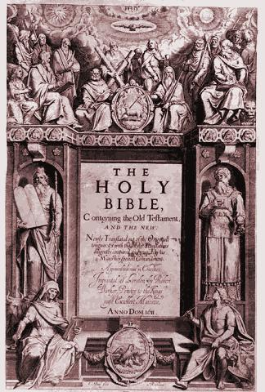
Choosing a Bible Translation
King James Version
64 scholars, under James I, 1611 (rev. 1873)
Acts 2:31
“…of the resurrection of Christ, that his soul was not left in hell…”
Gr. hades refers to the place of the dead not final punishment (cf. Rev. 20:13-14)

Slide 19
Choosing a Bible Translation
King James Version
Acts 12:4
“…intending after Easter to bring him forth to the people.”
Gr. pascha refers the Jewish feast of Passover, not the man-made memorial called “Easter.”

Slide 20
Choosing a Bible Translation
King James Version
1 John 5:7
“The Johnannine Comma”
“For there are three that bear record in heaven, the Father, the Word, and the Holy Ghost: and these three are one.”
No early ancient Greek mss contain this verse.
Erasmus’s first editions did not contain it.

Slide 21
Choosing a Bible Translation
King James Version
Obsolete Words:
Carriages (Acts 21:15) means baggage.
Script (Mark 6:8) means wallet or bag.
Fetched a compass (Acts 28:13) means sailed around.
Lewis Foster, Selecting a Translation of the Bible

Slide 22
Choosing a Bible Translation
King James Version
Changes of Meaning:
Letteth (2 Thess. 2:7) means restrains.
Prevent (1 Thess. 4:15) means precede.
Charger (Mark 6:25) means platter.
Conversation (Jas. 3:13) means conduct.
Lewis Foster, Selecting a Translation of the Bible

Slide 23
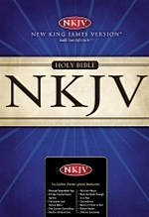
Choosing a Bible Translation
New King James Version
Nashville: Thomas Nelson Pub. , 1982
Not Perfect - Retains 1 John 5:7
Uses Textus Receptus
Assuming that any older text is more accurate to the original presumes that flawed or altered manuscripts would receive the same wear and use that accurate manuscripts would receive.
The NKJV cites in footnotes all pertinent evidence from modern discoveries.

Slide 24
Choosing a Bible Translation
New King James Version
The NKJV is the best choice currently available that maintains a connection to the vocabulary, influence, and resources of the KJV while using contemporary English corresponding directly to the wording and structure of the original text.
It is literal without being awkward. It is readable while maintaining the content of the original text.

Slide 25
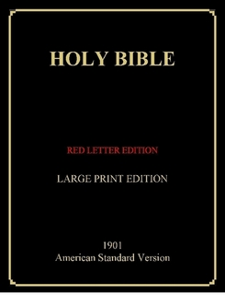
Choosing a Bible Translation
American Standard Version
(RV/ASV) 30 scholars supervised by Philip Schaff, 1901
Probably the most literal translation—thus somewhat awkward.
Used “Jehovah” instead of “LORD” for Hebrew name for God.
Retained “thou” for sg. and “ye” for pl.
Hard to find in print.

Slide 26
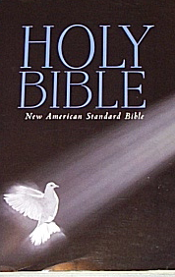
Choosing a Bible Translation
New American Standard Bible
Lockman Found.1971, rev. 1995
Overcomes awkwardness of ASV
Utilizes modern discoveries.
Utilizes more contemporary English than ASV.
This is an excellent translation, in spite of the fact that it moves readings from the Textus Receptus into the footnotes. This can prove confusing in study.

Slide 27
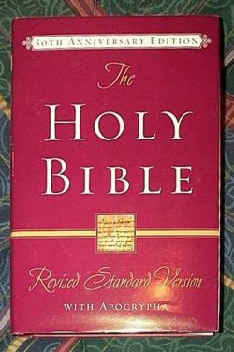
Choosing a Bible Translation
Revised Standard Version
Nashville: Thomas Nelson Pub. , 1952
Isaiah 7:14
“Therefore the Lord himself will give you a sign. Behold, a young woman shall conceive and bear a son, and shall call his name Imman’u-el”
Matthew 1:23 defines Heb. ‘almah as “virgin.”

Slide 28
Choosing a Bible Translation
New Revised Standard Version
National Council of Churches , 1989
Retains “young woman” in Isaiah 7:14.
Applies “gender-neutral” language in references to humans.
Retains masculine in references to Deity.

Slide 29
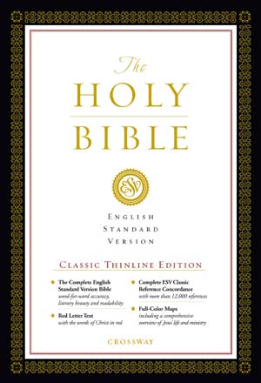
Choosing a Bible Translation
English Standard Version
Standard Bible Society. Wheaton, IL: Crossway, 2001
“Essentially literal”— “Transparent to the original text”
Very similar to the NASB.
Resisted efforts to impose “gender-neutral” language.
No italics to indicate editorial additions.

Slide 30
Choosing a Bible Translation
English Standard Version
Romans 8:5
“For those who live according to the flesh set their minds on the things of the flesh, but those who live according to the Spirit set their minds on the things of the Spirit”

Slide 31
Choosing a Bible Translation
English Standard Version
Romans 8:5
“For those who live according to the flesh set their minds on the things of the flesh, but those who live according to the Spirit set their minds on the things of the Spirit”
Should have italicized

Slide 32
Choosing a Bible Translation
English Standard Version
Matthew 16:18
“Gates of hell” should be “hades”
In Acts 2:31 and Luke 16:23 it uses “hades”

Slide 33
Choosing a Bible Translation
Recommended Translations
A ”formal equivalence” translation
King James Version
New King James Version
American Standard Version
New American Standard Version
(English Standard Version)

