Slide 1
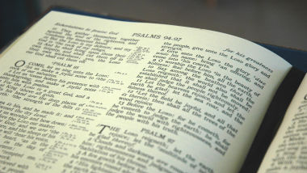
1 Timothy 2:1-4
“Therefore I exhort first of all that supplications, prayers, intercessions, and giving of thanks be made for all men, for kings and all who are in authority, that we may lead a quiet and…”

Slide 2
1 Timothy 2:1-4
“…peaceable life in all godliness and reverence. For this is good and acceptable in the sight of God our Savior, who desires all men to be saved and to come to the knowledge of the truth.”

Slide 3
Heaven’s Concern for the Lost
They rejoice when the lost are saved (Luke 15:7-10).
The Angels Are Concerned

Slide 4
Heaven’s Concern for the Lost
1. He is called “Our Savior” (1 Tim. 1:1).
2. He saves us…
By His Love (Rom. 5:6-8).
By His Grace (Titus 2:11-15).
By His Mercy (Titus 3:4-7).
By His Patience (2 Pet. 3:9; Rom. 2:2-4).
God the Father is Concerned

Slide 5
Heaven’s Concern for the Lost
He is the Spirit of Truth (John 16:12-13; 2 Pet. 1:3).
He is said to…
Convict us of sin (John 16:8-9; Heb. 4:12).
He invites us (Rev. 22:17; 2 Thess. 2:13-14).
He wants to dwell in us (Titus 3:5-6; Eph. 3:14-17; Rom. 8:5).
The Holy Spirit is Concerned

Slide 6
Heaven’s Concern for the Lost
1. He too, is “Our Savior” (Matt. 1:21; Luke 2:8-11).
2. He saves…
By His Blood (Rev. 1:4-6).
By His Gospel (1 Cor. 15:1-2).
By His Authority (Matt. 28:16-20; Rev. 1:18).
Jesus is Concerned

