Slide 1
Genesis 2:21-25
“And the LORD God caused a deep sleep to fall on Adam, and he slept; and He took one of his ribs, and closed up the flesh in its place. Then the rib which the LORD God had taken from man He made into a woman, and He brought her to the man. And Adam said: ‘This is now bone of my bones And flesh of my flesh; . . .”

Slide 2
Genesis 2:21-25
“. . .She shall be called Woman, Because she was taken out of Man.’ Therefore a man shall leave his father and mother and be joined to his wife, and they shall become one flesh. And they were both naked, the man and his wife, and were not ashamed” (NKJV).

Slide 3
Genesis 3:6-7
“So when the woman saw that the tree was good for food, that it was pleasant to the eyes, and a tree desirable to make one wise, she took of its fruit and ate. She also gave to her husband with her, and he ate. Then the eyes of both of them were opened, and they knew that they were naked; and they sewed fig leaves together and made themselves coverings.”

Slide 4
Genesis 3:9-11
“Then the LORD God called to Adam and said to him, ‘Where are you?’ So he said, ‘I heard Your voice in the garden, and I was afraid because I was naked; and I hid myself.’ And He said, ‘Who told you that you were naked? Have you eaten from the tree of which I commanded you that you should not eat?.’”

Slide 5
Genesis 3:20-21
“And Adam called his wife’s name Eve, because she was the mother of all living. Also for Adam and his wife the LORD God made tunics of skin, and clothed them.”

Slide 6
Why Do Humans Need Clothes?
Why Do We?
Animals Don’t Need Clothes

Slide 7
Why Do Humans Need Clothes?
Evolutionist Say It’s An Adaptation
As clothing was used to shield us from the elements body hair slowly fell away.
If so, that would not be a favorable adaptation because it leaves us more vulnerable to the elements.

Slide 8
Why Do Humans Need Clothes?
Scripture doesn’t directly answer that question.
They were not required in the marriage bond (Gen. 2:25).
No sin or shame with spouse
Shame came in exposure to others (Gen. 3:10).

Slide 9
Some Observations
When They Became Necessary. . .
The couple’s choice was insufficient.

Slide 10
Some Observations

Slide 11
Some Observations
When They Became Necessary. . .
The couple’s choice was insufficient.
What God provided was sufficient.

Slide 12
Some Observations

Slide 13
Why Do Humans Need Clothes?
Scripture Addresses Their Purpose
For warmth and protection (Deut. 24:12-13, 17; Job 22:6; 24:7, 10).

Slide 14
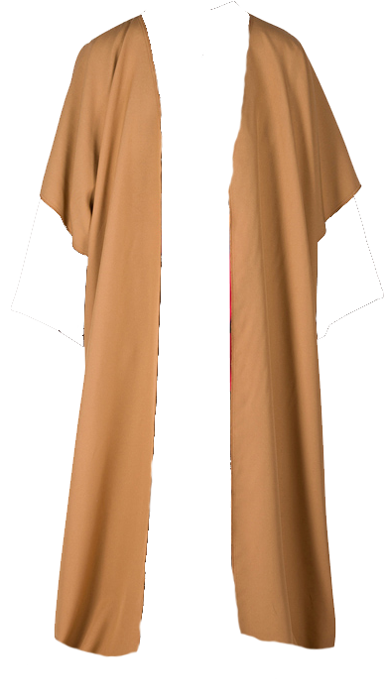
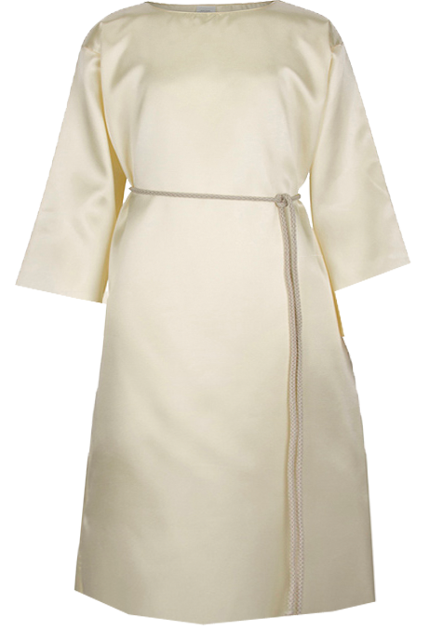
Why Do Humans Need Clothes?
Tunic
Cloak
Matthew 5:40

Slide 15
Why Do Humans Need Clothes?
Scripture Addresses Their Purpose
For warmth and protection (Deut. 24:12-13, 17; Job 22:6; 24:7, 10).
To cover nakedness reserved for one’s spouse (Hos. 2:9; Isa. 47:3; Gen. 9:20-23; Lev. 18:6-19).

Slide 16
Some Observations
Whatever “Nakedness” Is. . .
It was shameful even for family to view (Gen. 9:20-23).
Alcohol (Gen. 9:21; cf. Lam. 4:21; Hab. 2:15)
A person’s “nakedness” belongs to him or her and to his or her spouse (Lev. 18:8; cf. Gen. 2:25; 3:10).

Slide 17
What Is Nakedness?
It Is Not What Our Culture Says

Slide 18
What Is Nakedness?
Does This Cover Nakedness?

Slide 19
What Is Nakedness?
Many Clothes in Our World Offer Little More Coverage.

Slide 20
What Is Nakedness?
What Is Nakedness to God?
Sometimes, a figure for vulnerability
Joseph to his brothers (Gen. 42:12)
The nations and Israel (Nah. 3:5)
Sometimes, not total nakedness
Keeping a pledge garment (Job 22:6)
The poor (Isa. 58:7; Matt. 25:36, 38, 43, 44; Rom. 8:35; Jas. 2:15)
Paul (2 Cor. 11:27)

Slide 21
Why Do Humans Need Clothes?
Cloak
Tunic
Inner Garment
(2 Sam. 6:14, 20; John 21:7)

Slide 22
What Is Nakedness?
What Is Nakedness to God?
There are unpresentable parts
Illustration of church (1 Cor. 12:23-24)
Punishment: “secret parts” (Isa. 3:17)
Nakedness involves more
Priest’s tunics (Exod. 28:40-42)
The Lord’s warning to Israel: “uncover the thigh” = “nakedness” uncovered (Isa. 47:1-3)
Uncovering what the tunic covers

Slide 23
Why Should This Matter to Me?
Christians Shine Light to the World
The Christian Order (1 Tim. 2:8-10)
Modesty, Propriety, Moderation, Godliness
Not a display, to show wealth, flaunt beauty
Male and female issue (not only women)
No Stumbling Blocks (Matt. 18:6-9).
Male (visual) – Female (closeness) (Matt. 5:28-30)
Don’t give away what belongs to your spouse
Lessons to young; discouragement to others

